Slide 1


SELF
INTRODUCTION
NAME: ANDREW KINNIE LAHAI
UNIVERSITY: UNIVERSITY OF MANAGEMENT AND TECHNOLOGY
DEPARTMENT: MANAGEMENT INFORMATION SYSTEM
LEVEL: YEAR THREE (3)
COURSE: DIVE INTO CODE (DIC)
PROJECT: FEATURE SELECTION AND DATA VISUALIZATION
NATIONALITY: SIERRA LEONEAN

Slide 2
Feature Selection and Data Visualization In Sierra Leone
Introduction
In this data analysis report, I usually focus on feature visualization and selection as a different from other seeds. Feature selection with correlation, univariate feature selection, recursive feature elimination, recursive feature elimination with cross validation and tree based feature selection methods are used with random forest classification. Apart from these, principle component analysis are used to observe number of components.

Slide 3
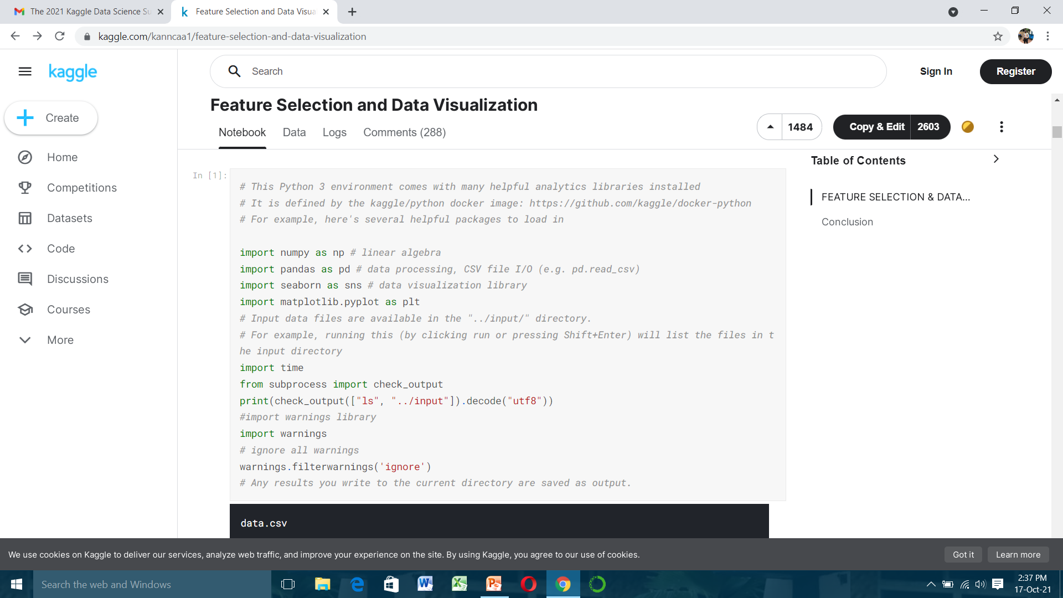

Slide 4
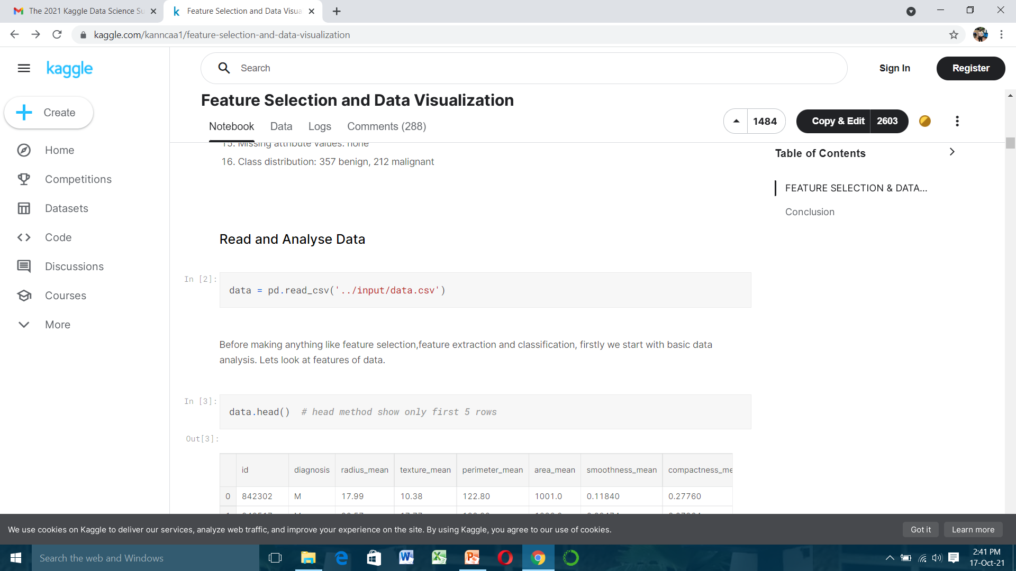
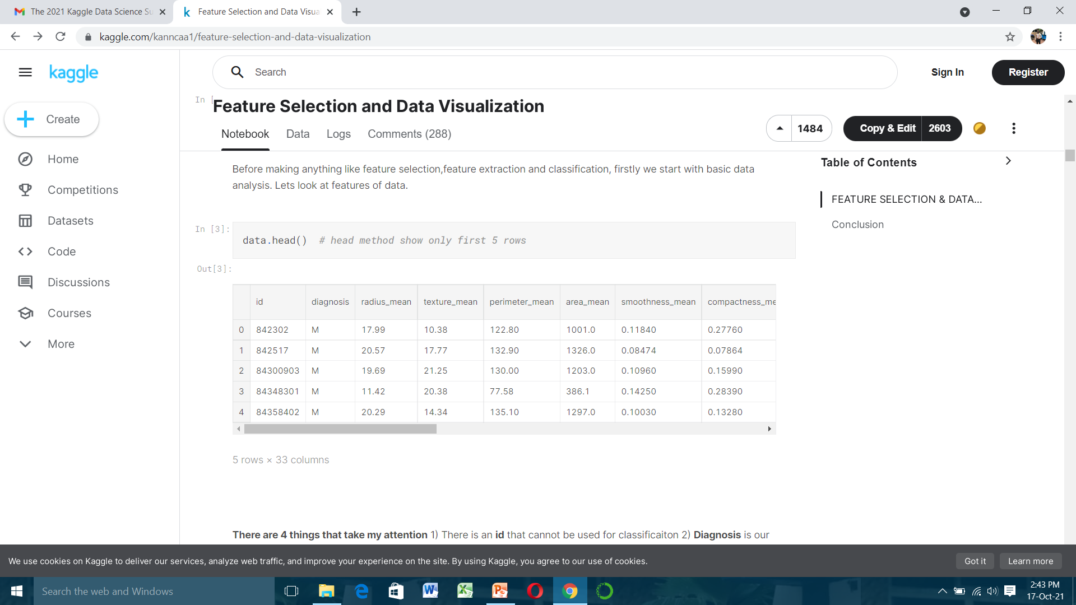

Slide 5
There are 4 things that take my attention:
1) There is an id that cannot be used for classification 2) Diagnosis is our class label
3) Unnamed: 32 feature includes NaN so we do not need it. 4) I do not have any idea about other feature names actually I do not need because machine learning is awesome :)
Therefore, drop these unnecessary features. However do not forget this is not a feature selection. This is like a browse a pub, we do not choose our drink yet !!!

Slide 6
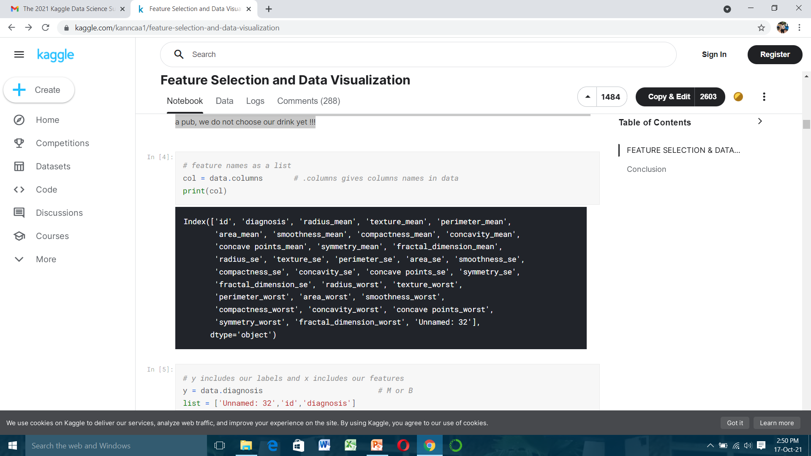

Slide 7
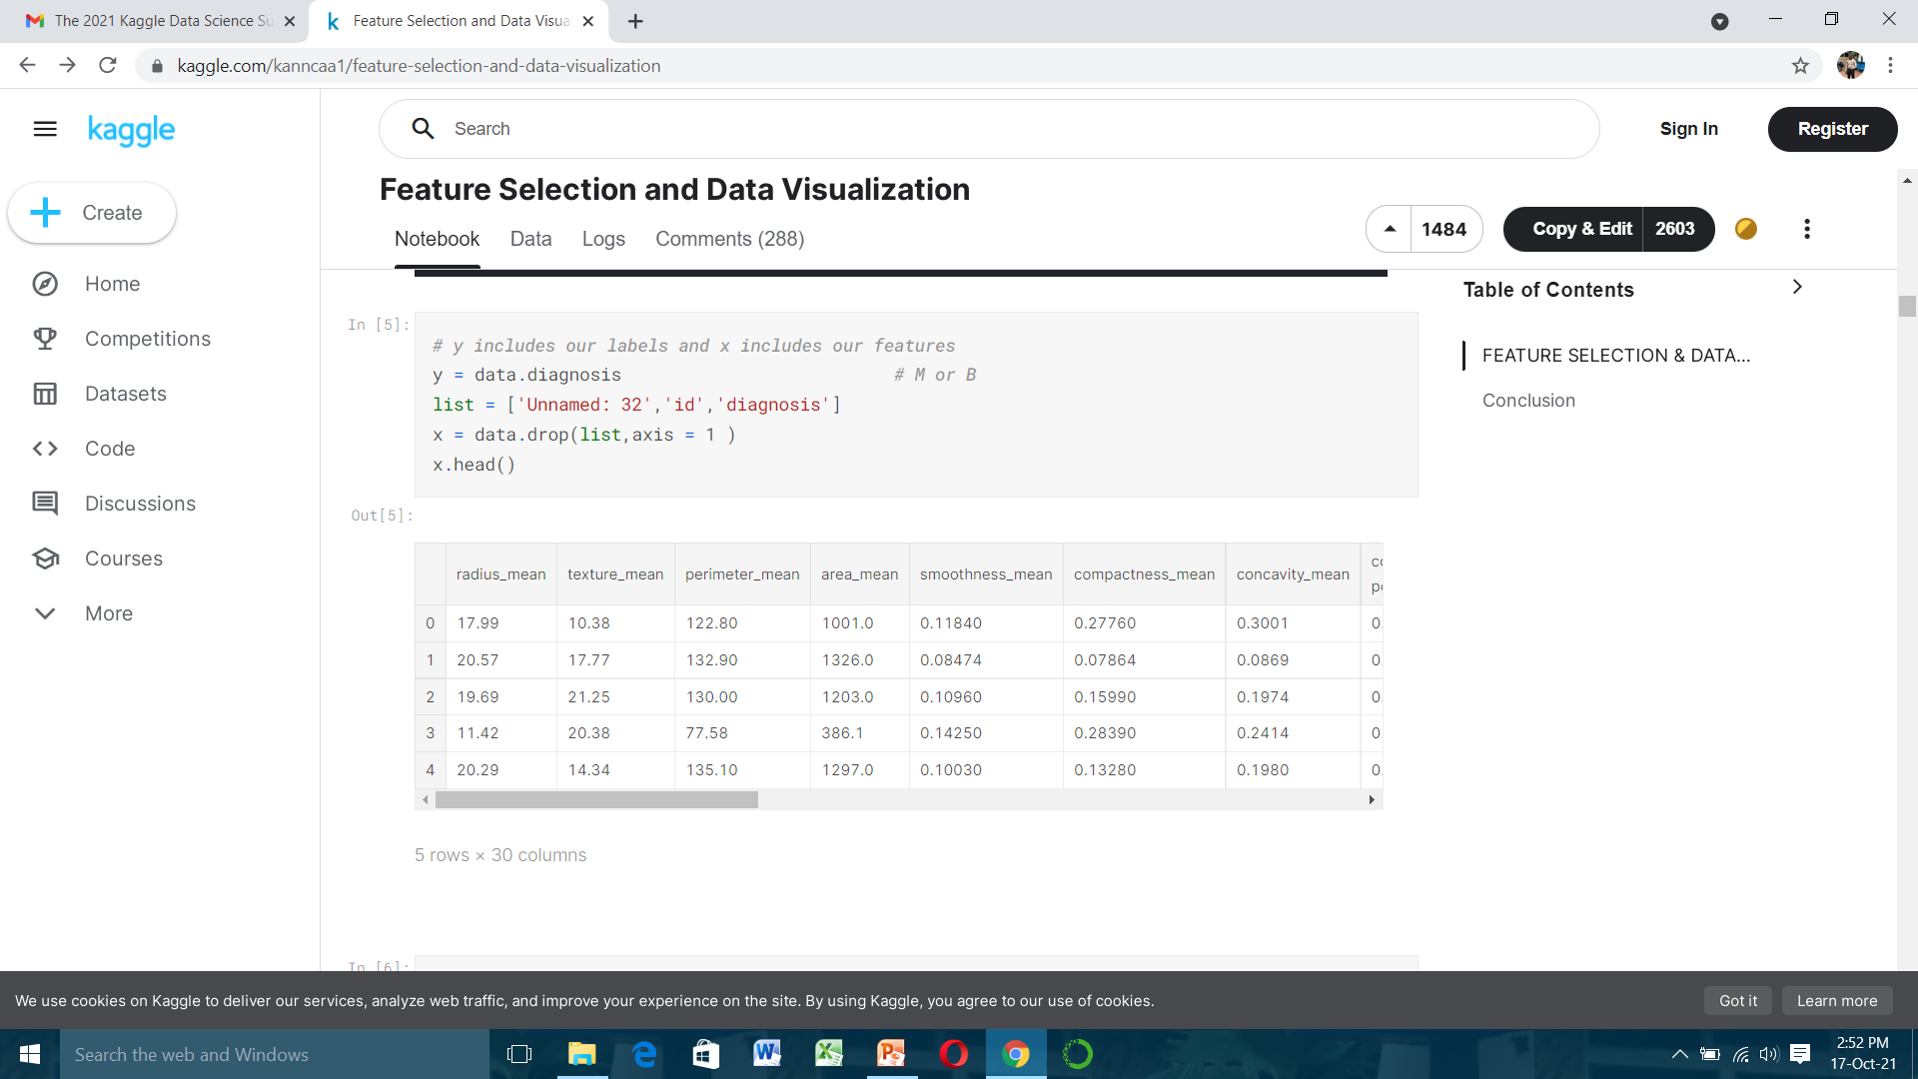

Slide 8
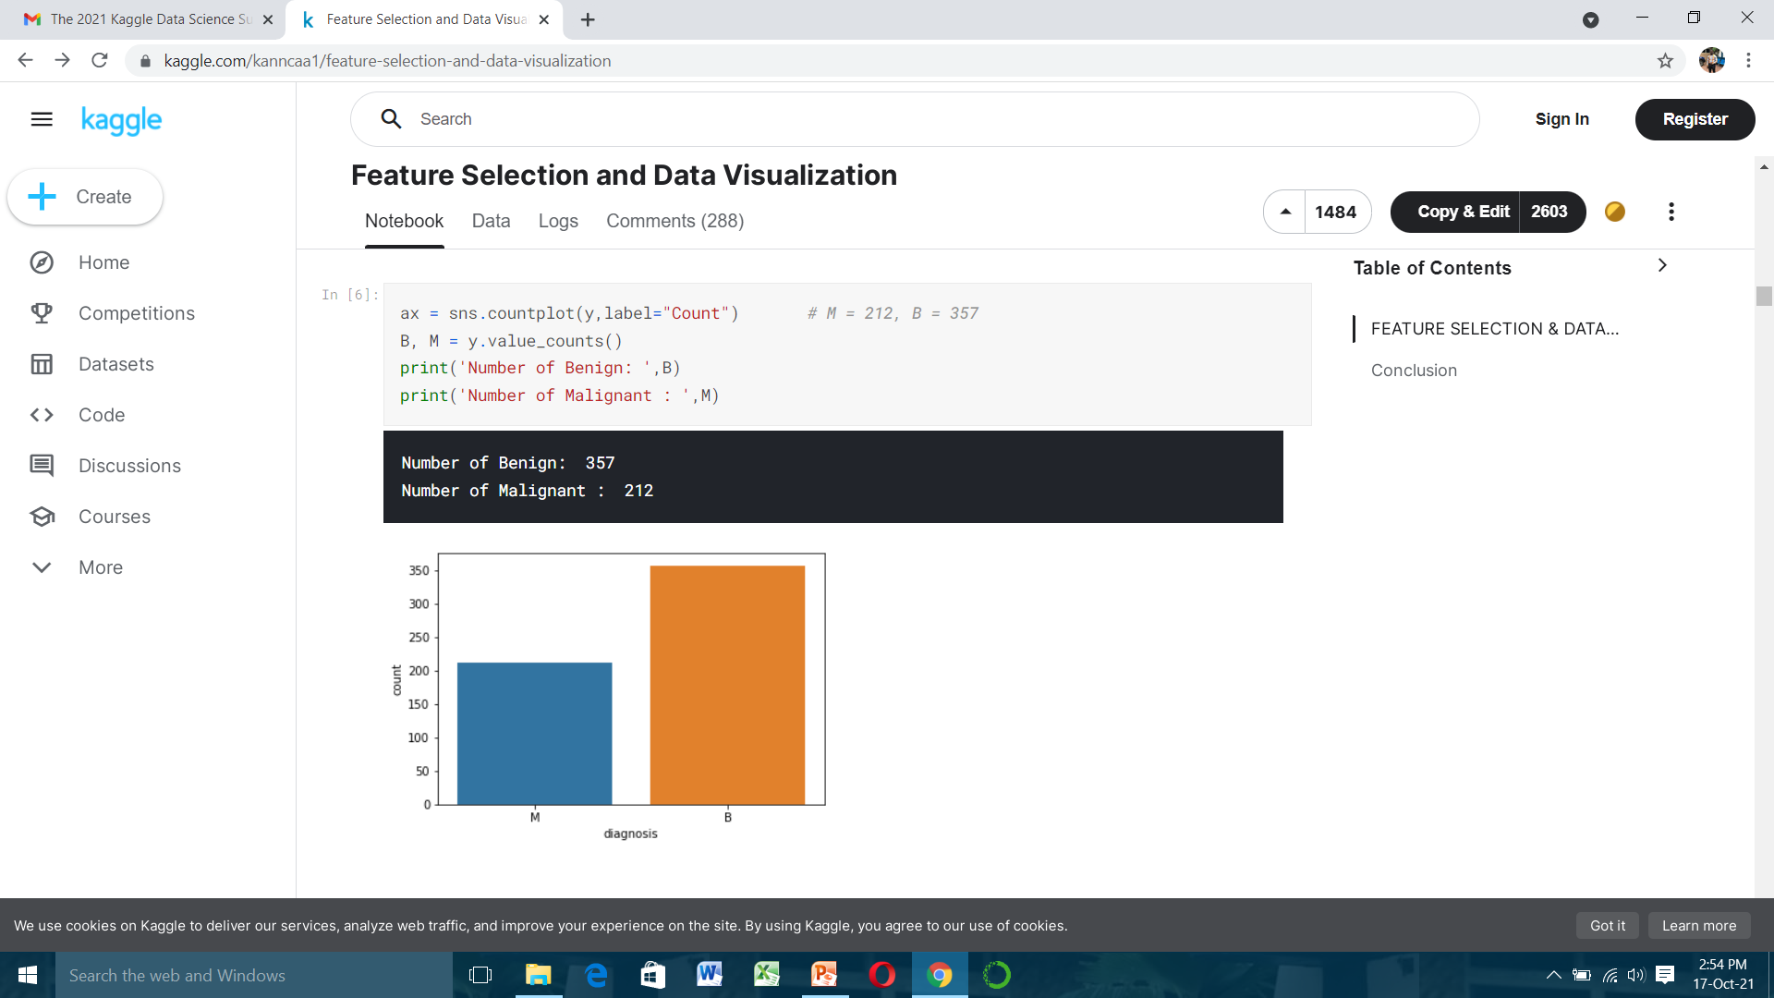

Slide 9
Okay, now we have features but what does they mean or actually how much do we need to know about these features The answer is that we do not need to know meaning of these features however in order to imagine in our mind we should know something like variance, stand art deviation, number of sample (count) or max min values. These type of information helps to understand about what is going on data. For example , the question is appeared in my mind the area mean feature's max value is 2500 and smoothness mean features' max 0.16340. Therefore do we need standardization or normalization before visualization, feature selection, feature extraction or classification? The answer is yes and no not surprising ha :) Anyway lets go step by step and start with visualization.

Slide 10
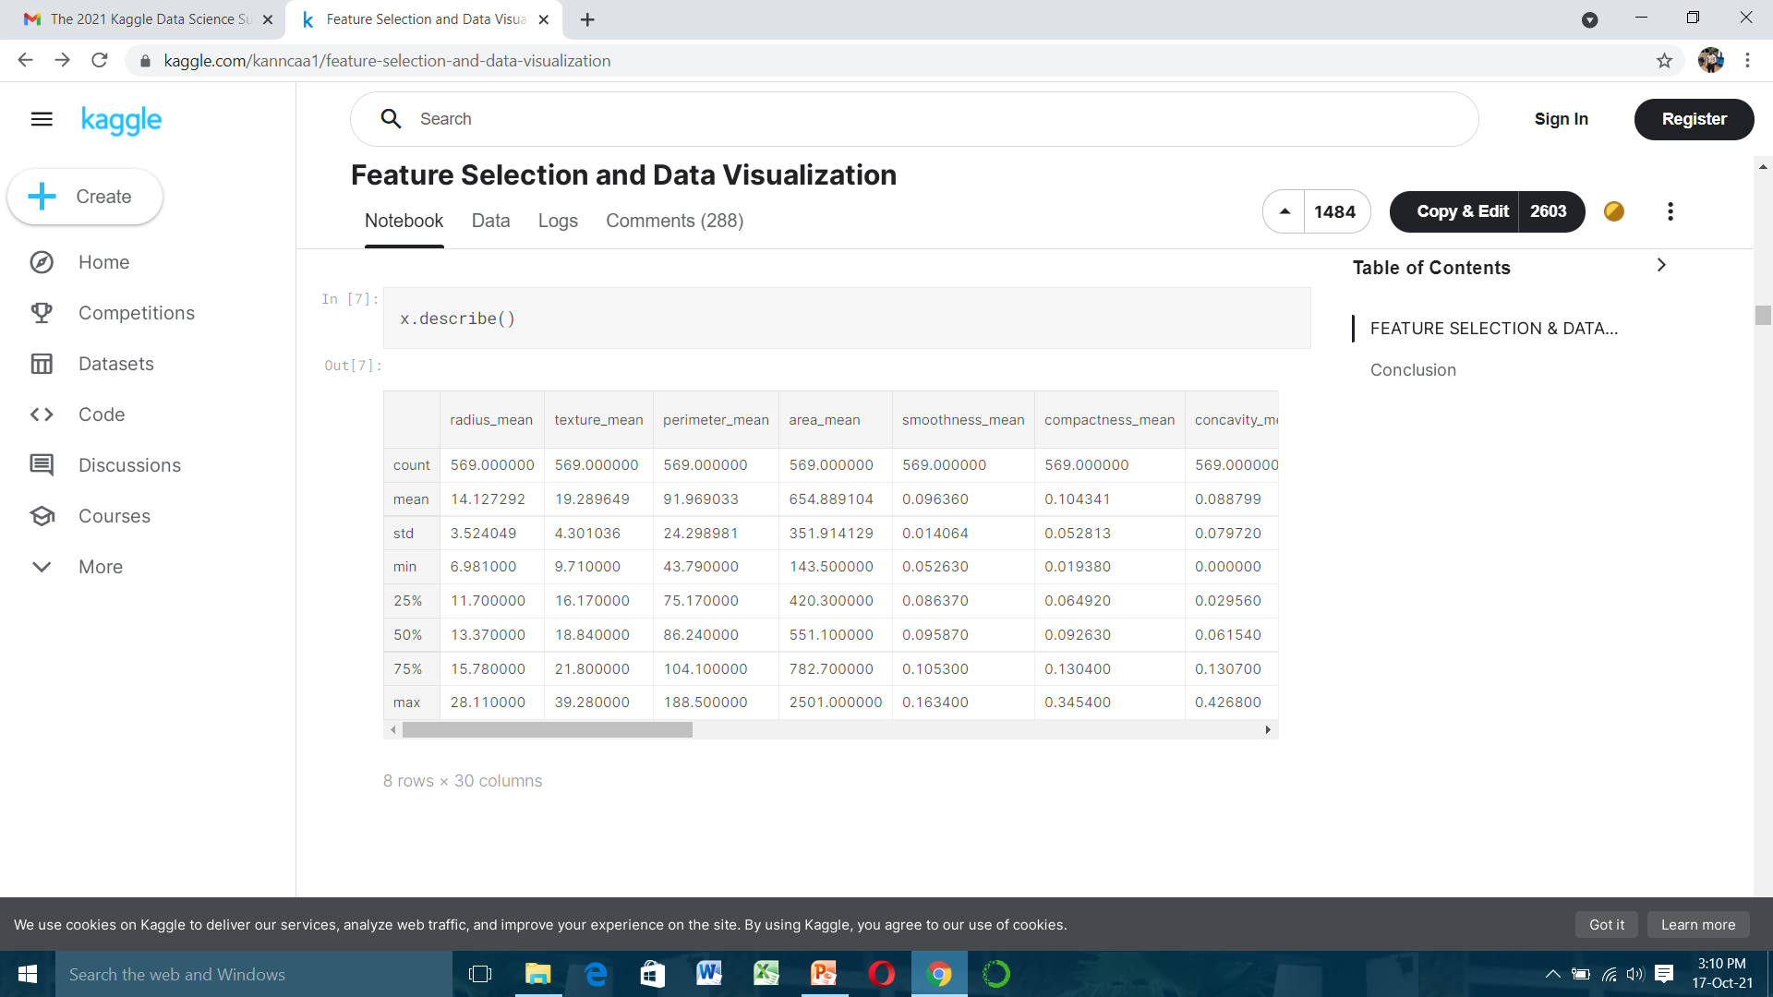

Slide 11
Visualization
In order to visualization data we are going to use seaborn plots that is not used in other kernels to inform you and for diversity of plots. What I use in real life is mostly violin plot and swarm plot. Do not forget we are not selecting feature, we are trying to know data like looking at the drink list at the pub door.
Before violin and swarm plot we need to normalization or standardization. Because differences between values of features are very high to observe on plot. I plot features in 3 group and each group includes 10 features to observe better.

Slide 12
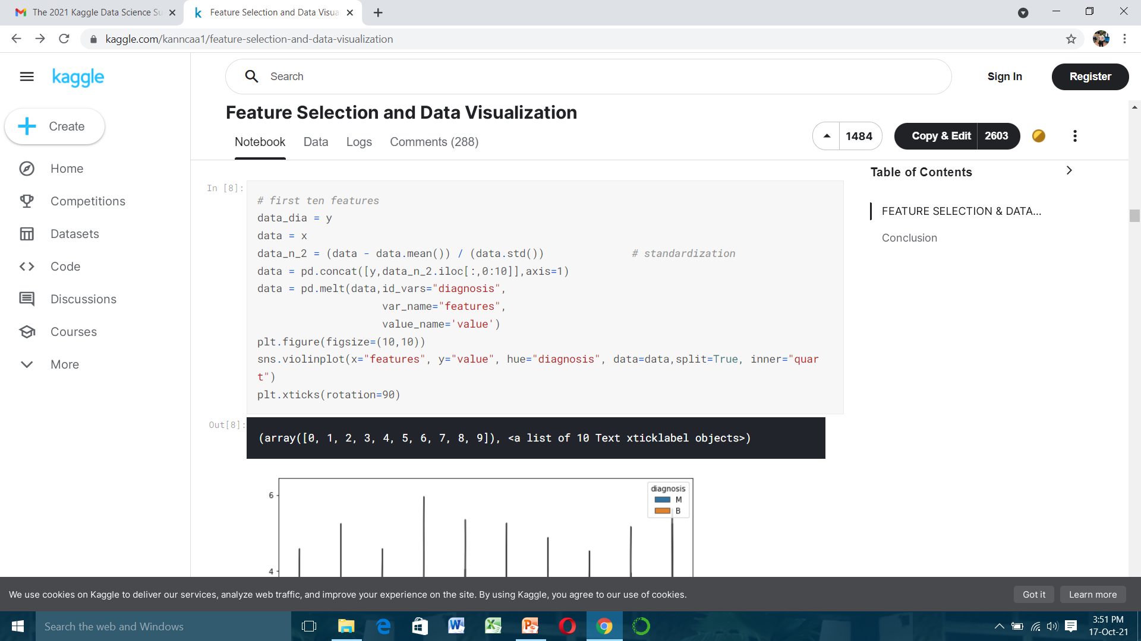

Slide 13
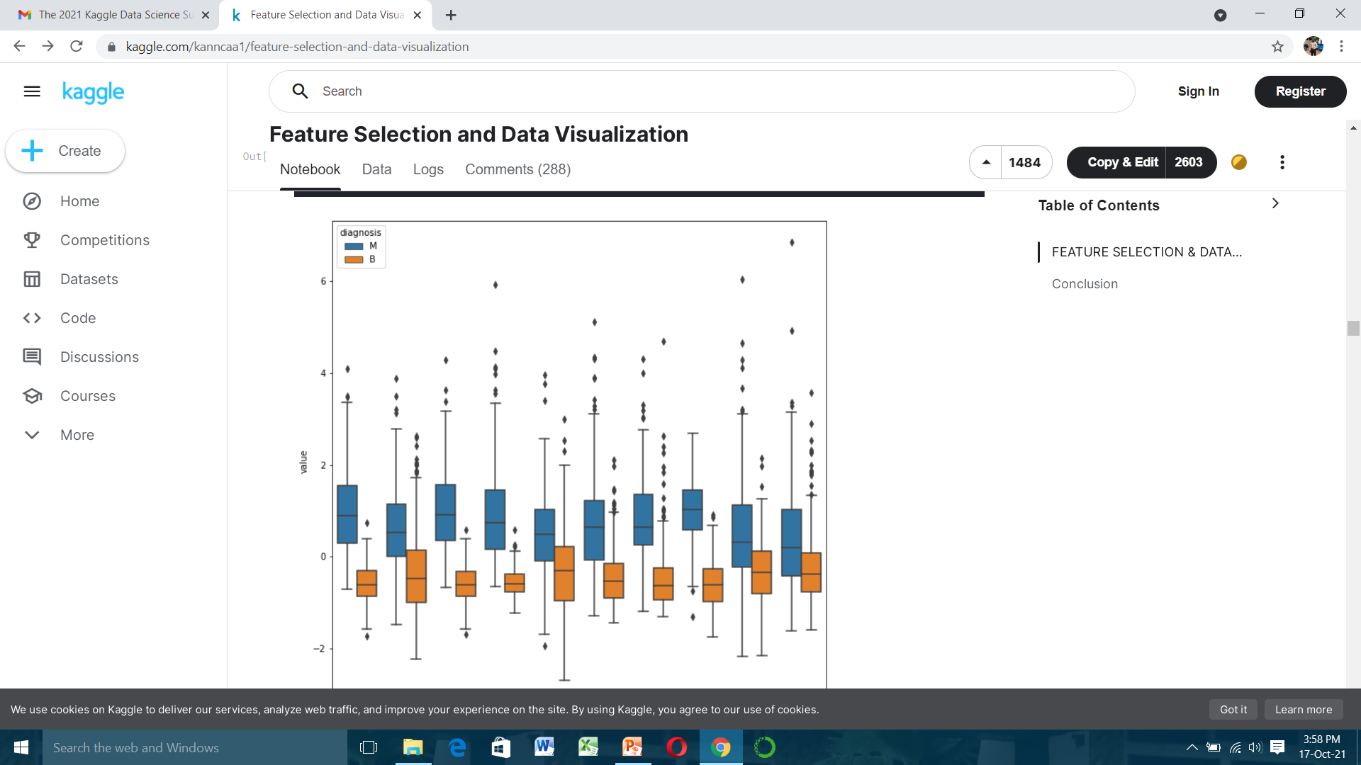
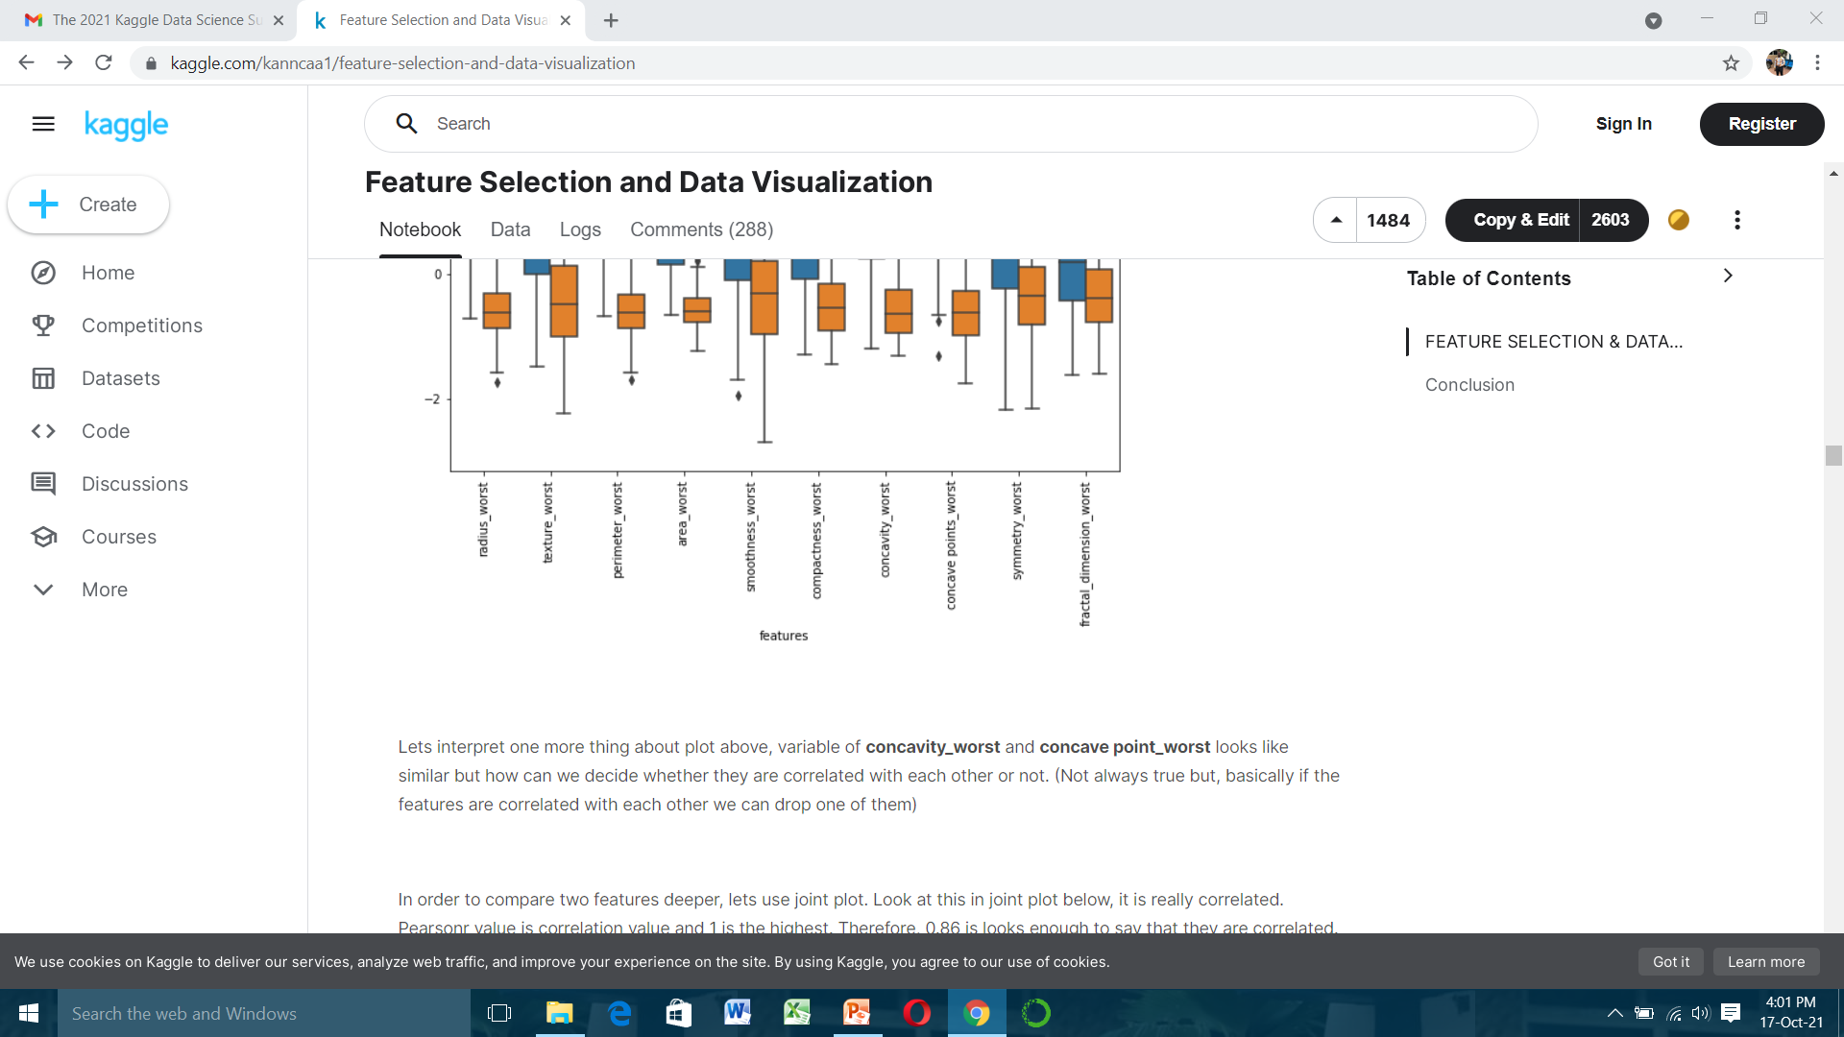

Slide 14
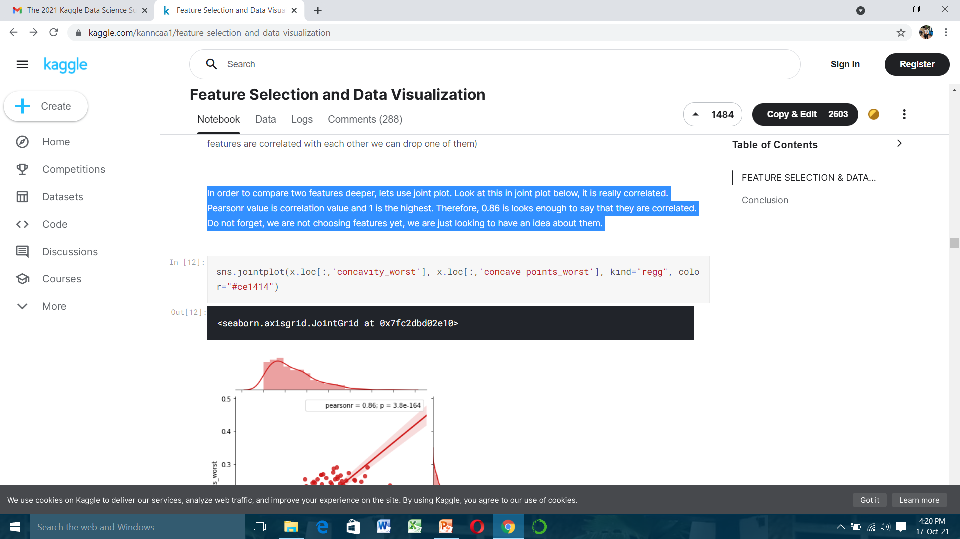
Lets interpret one more thing about plot above, variable of concavity worst and concave point worst looks like similar but how can we decide whether they are correlated with each other or not. (Not always true but, basically if the features are correlated with each other we can drop one of them)
In order to compare two features deeper, lets use joint plot. Look at this in joint plot below, it is really correlated. Pearsonr value is correlation value and 1 is the highest. Therefore, 0.86 is looks enough to say that they are correlated. Do not forget, we are not choosing features yet, we are just looking to have an idea about them.

Slide 15
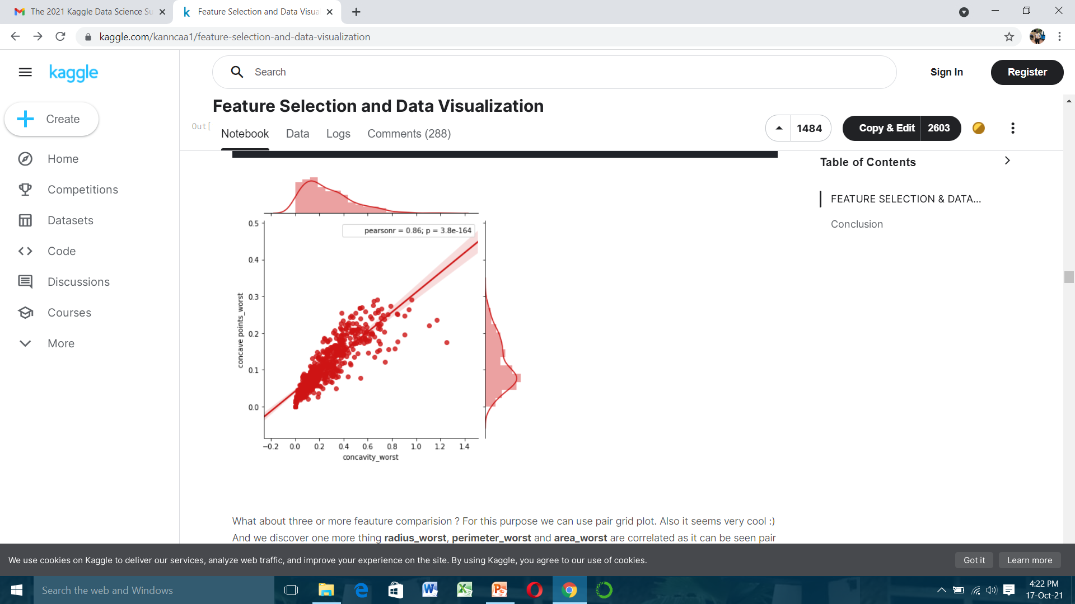

Slide 16
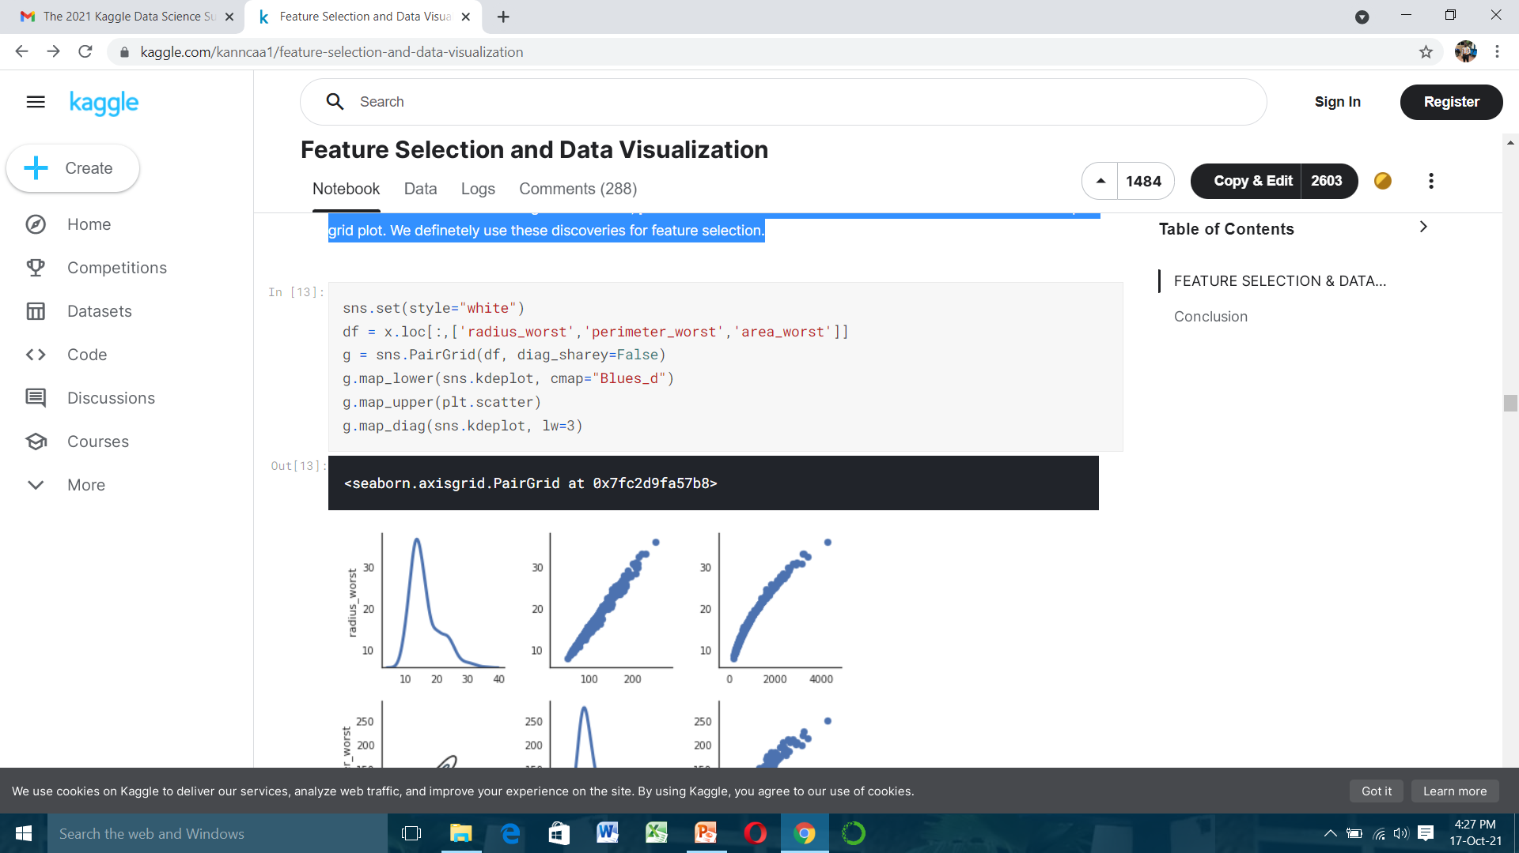
What about three or more feature comparisons ? For this purpose we can use pair grid plot. Also it seems very cool :) And we discover one more thing radius worst, perimeter worst and area worst are correlated as it can be seen pair grid plot. We definitely use these discoveries for feature selection.

Slide 17
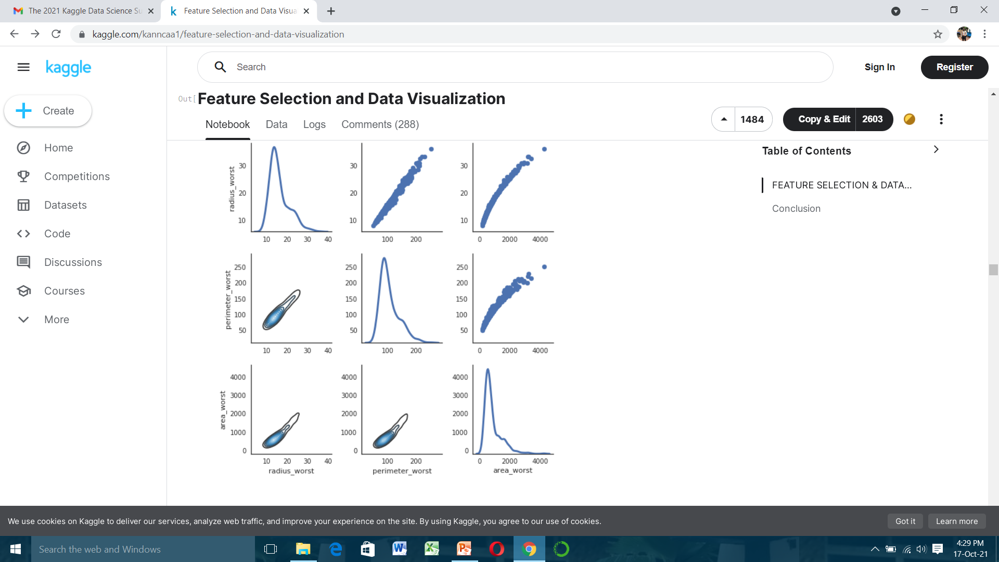

Slide 18
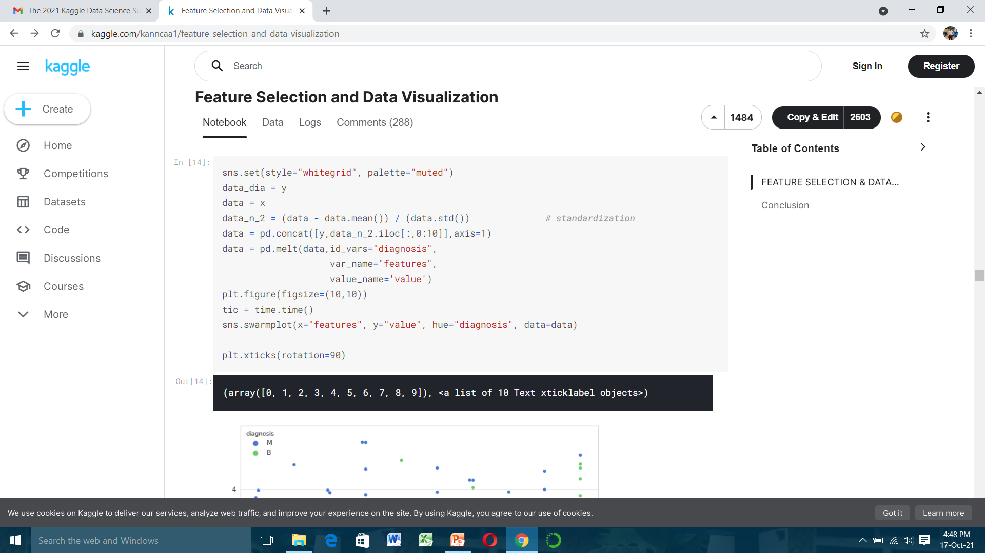
Up to this point, we make some comments and discoveries on data already. If you like what we did, I am sure swarm plot will open the pub's door :)
In swarm plot, I will do three part like violin plot not to make plot very complex appearance

Slide 19
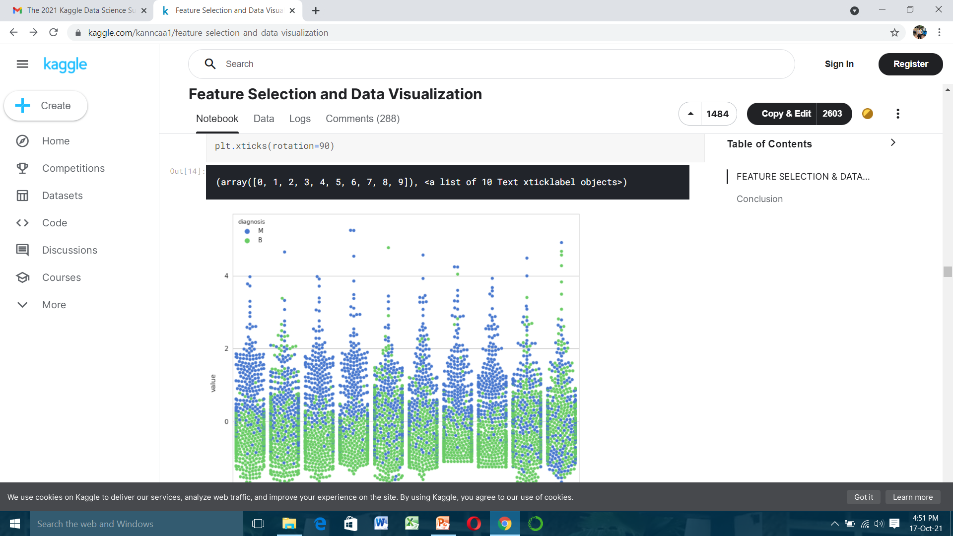
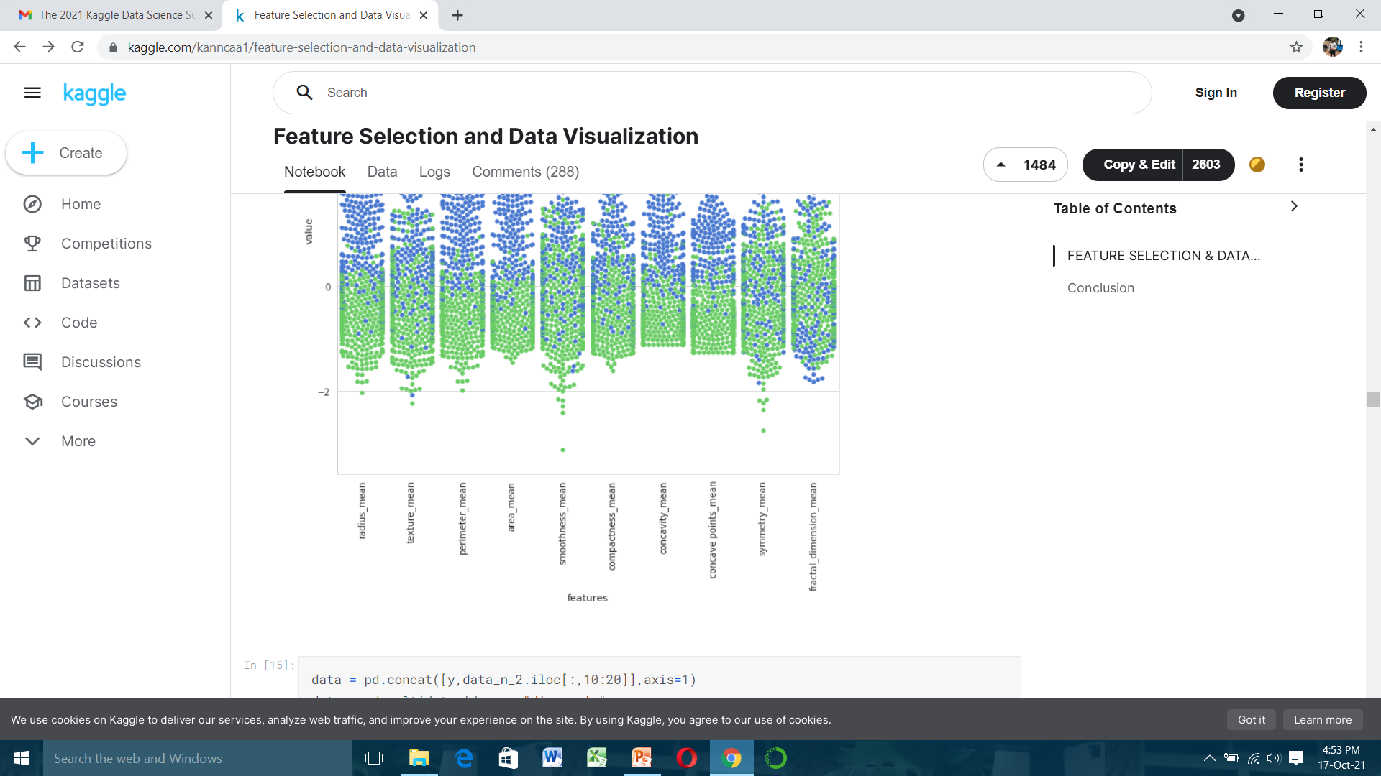

Slide 20
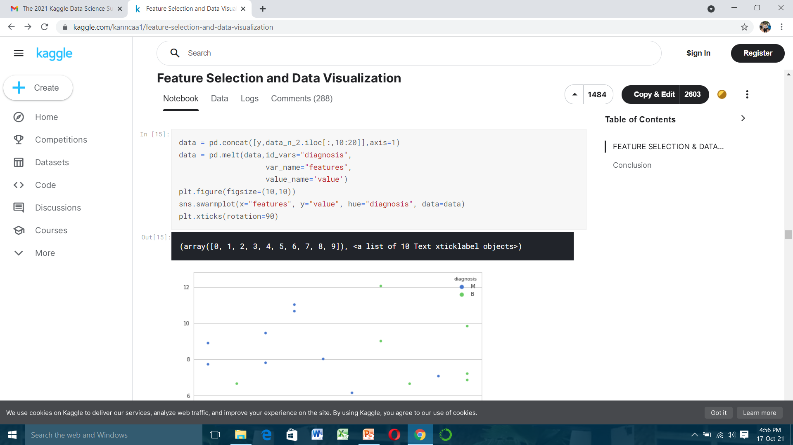

Slide 21
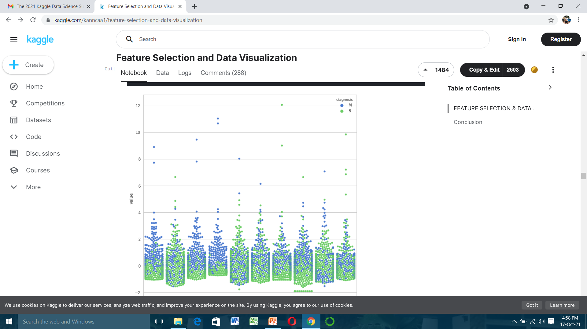
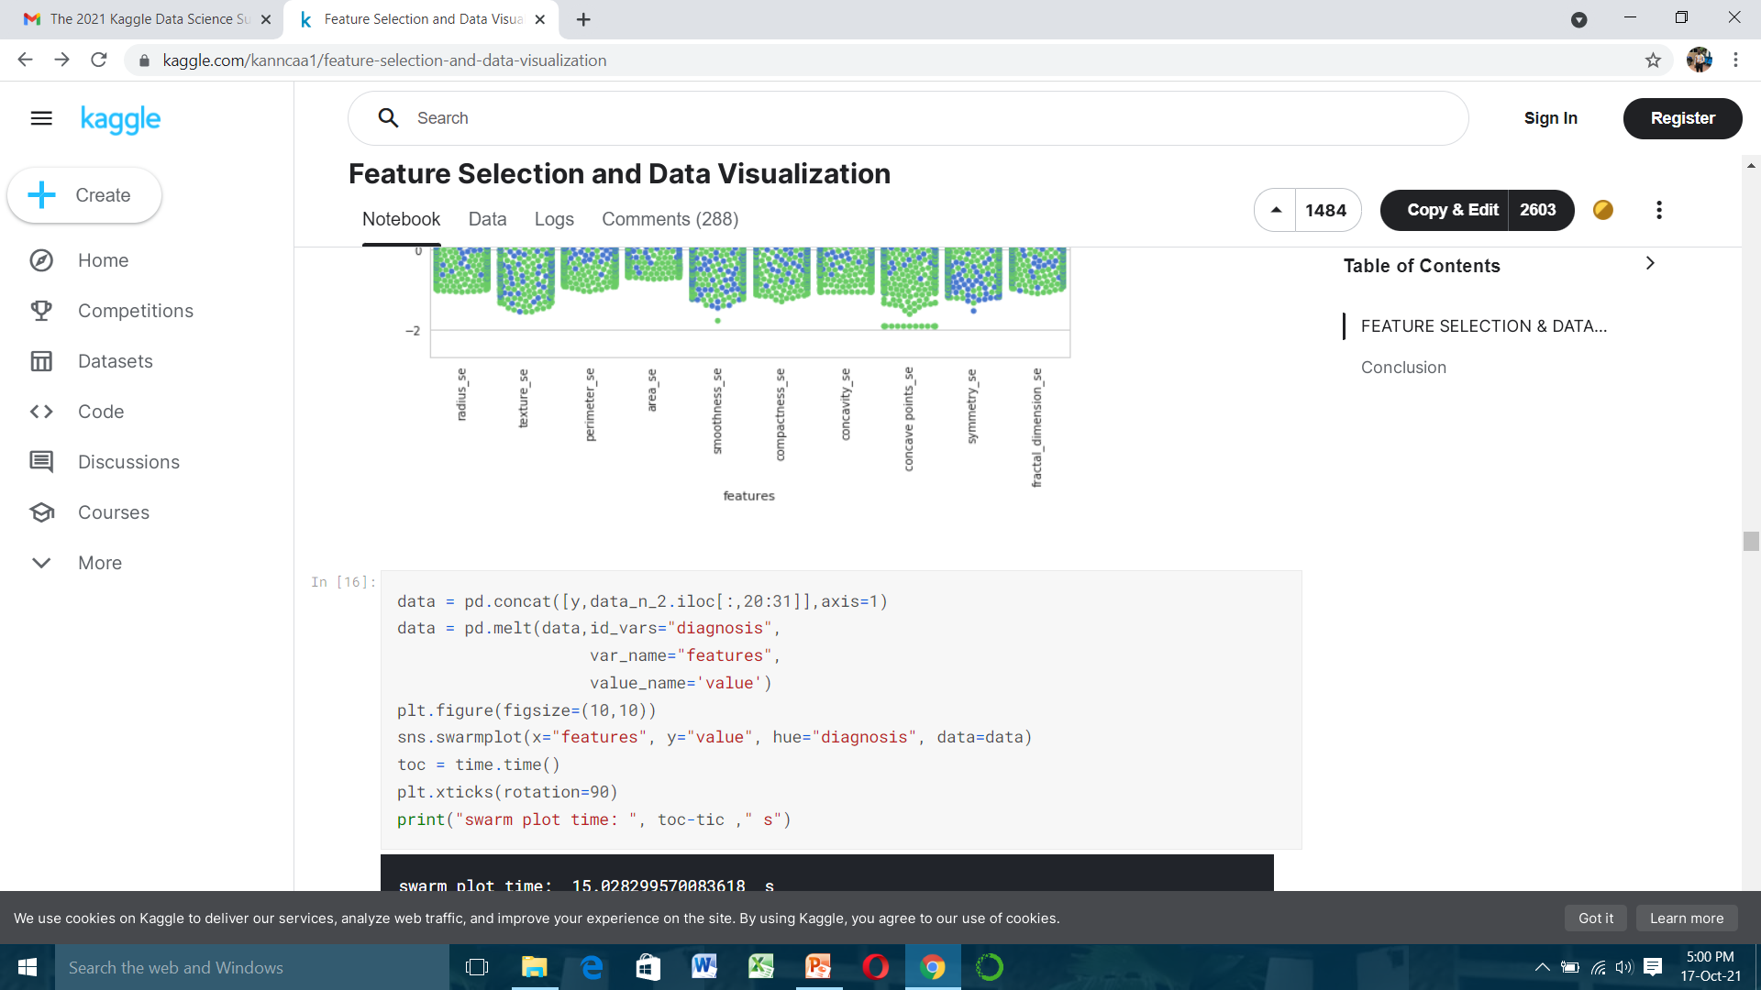

Slide 22
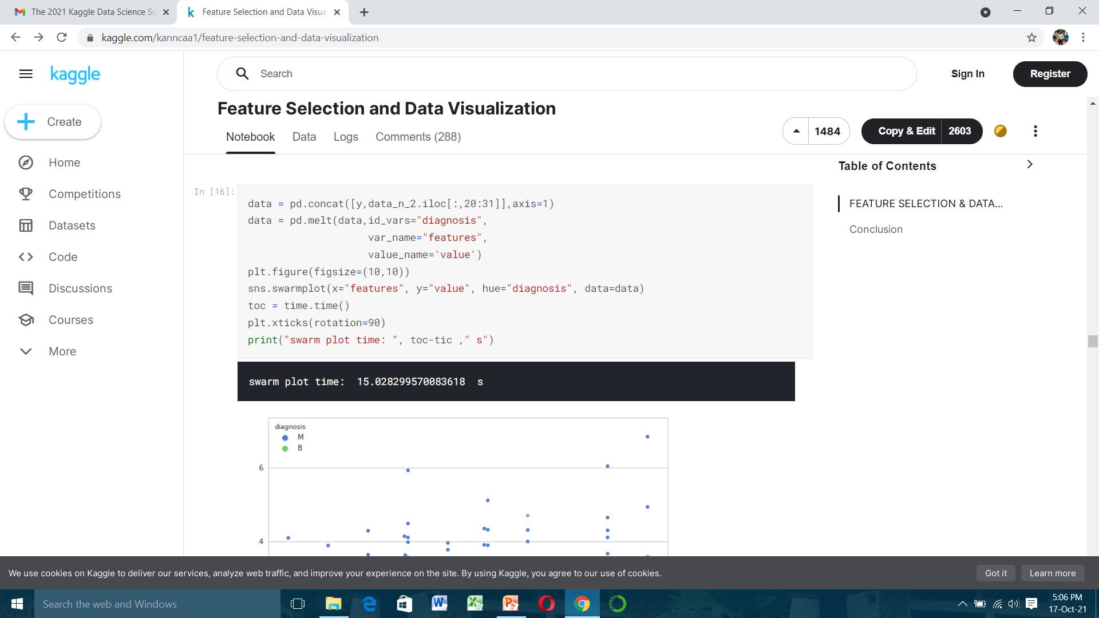

Slide 23
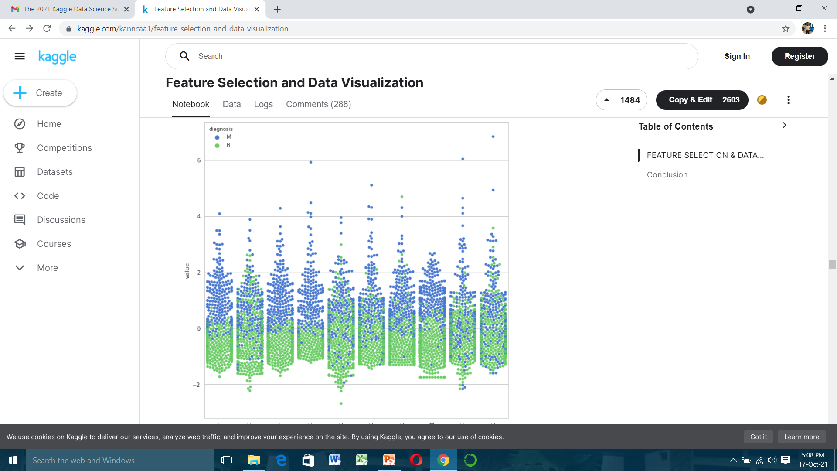
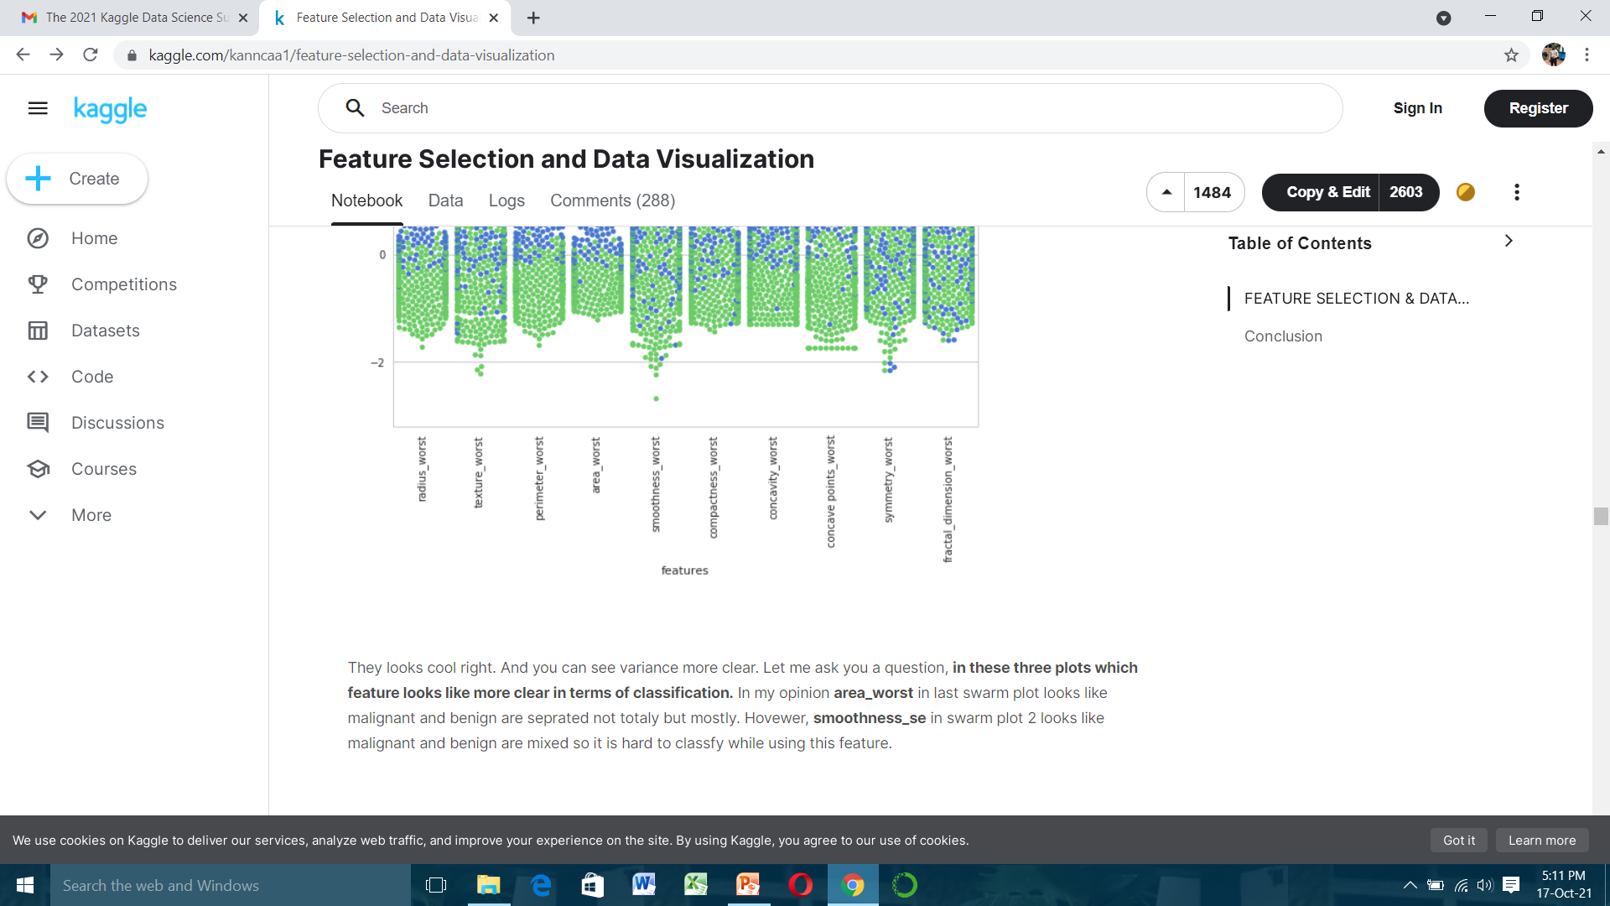

Slide 24
They looks cool right. And you can see variance more clear. Let me ask you a question, in these three plots which feature looks like more clear in terms of classification. In my opinion area worst in last swarm plot looks like malignant and benign are separated not totally but mostly. However, smoothness's in swarm plot 2 looks like malignant and benign are mixed so it is hard to classify while using this feature.
Well, finally we are in the pub and lets choose our drinks at feature selection part while using heat map(correlation matrix).
Feature Selection and Random Forest Classification
Today our purpose is to try new cocktails. For example, we are finally in the pub and we want to drink different tastes. Therefore, we need to compare ingredients of drinks. If one of them includes lemon, after drinking it we need to eliminate other drinks which includes lemon so as to experience very different tastes.
In this part we will select feature with different methods that are feature selection with correlation, univariate feature selection, recursive feature elimination (RFE), recursive feature elimination with cross validation (RFECV) and tree based feature selection. We will use random forest classification in order to train our model and predict.

Slide 25
1) Feature selection with correlation and random forest classification
As it can be seen in map heat figure radius mean, perimeter mean and area mean are correlated with each other so we will use only area mean. If you ask how i choose area mean as a feature to use, well actually there is no correct answer, I just look at swarm plots and area mean looks like clear for me but we cannot make exact separation among other correlated features without trying. So lets find other correlated features and look accuracy with random forest classifier.
Compactness mean, concavity mean and concave points mean are correlated with each other. Therefore I only choose concavity mean. Apart from these, radiuses, perimeters and areas are correlated and I only use areas. radius worst, perimeter worst and area worst are correlated so I use area worst. Compactness worst, concavity worst and concave points worst so I use concavity worst. Compactness, concavity and concave points so I use concavities. texture mean and texture worst are correlated and I use texture mean. area worst and area mean are correlated, I use area mean.

Slide 26
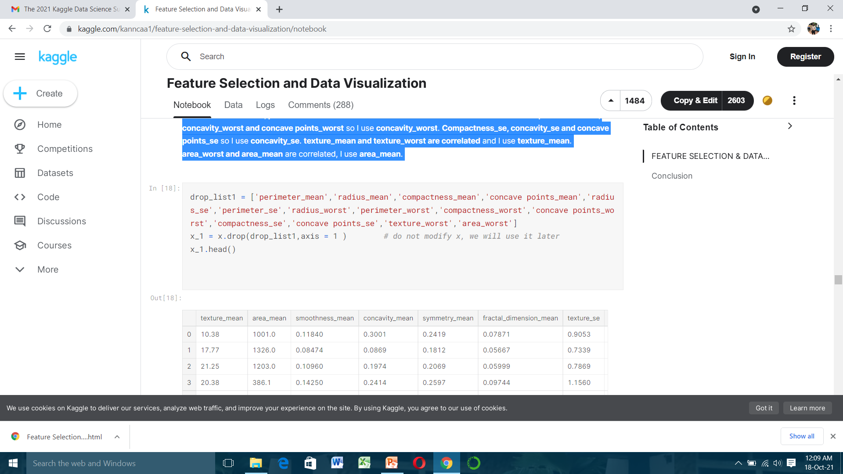
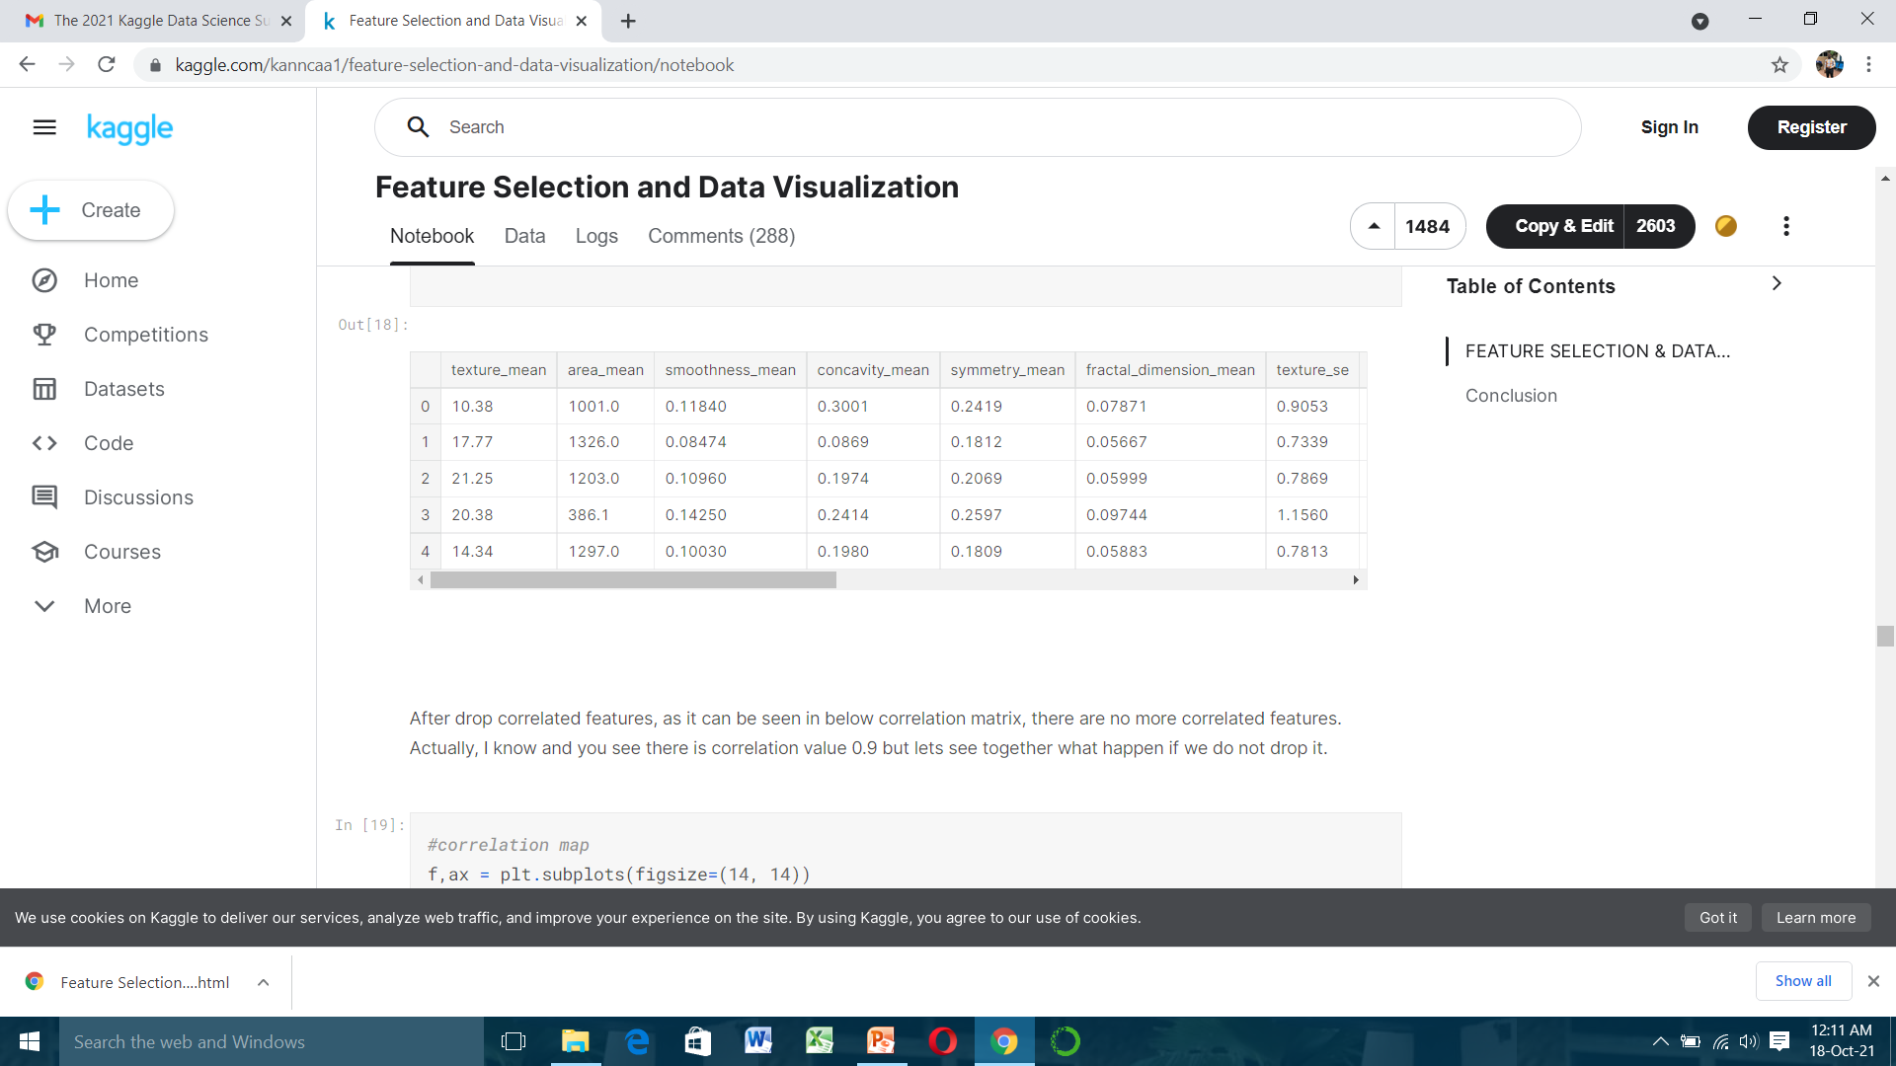

Slide 27
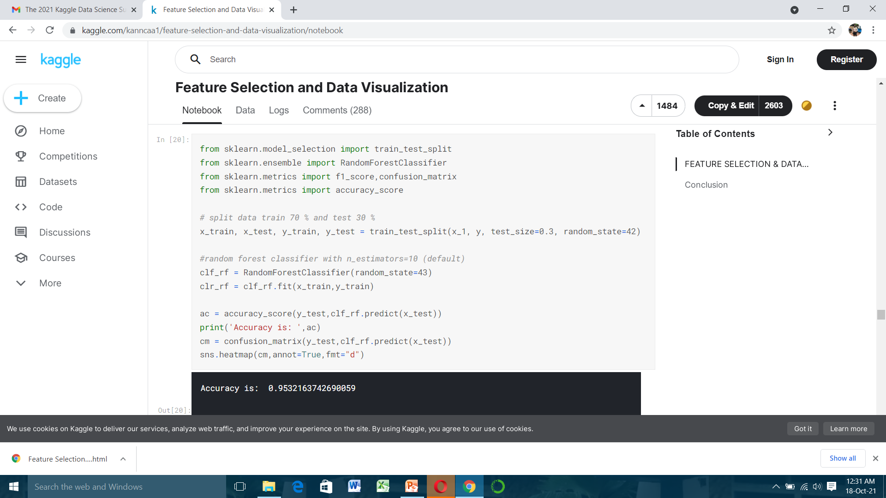
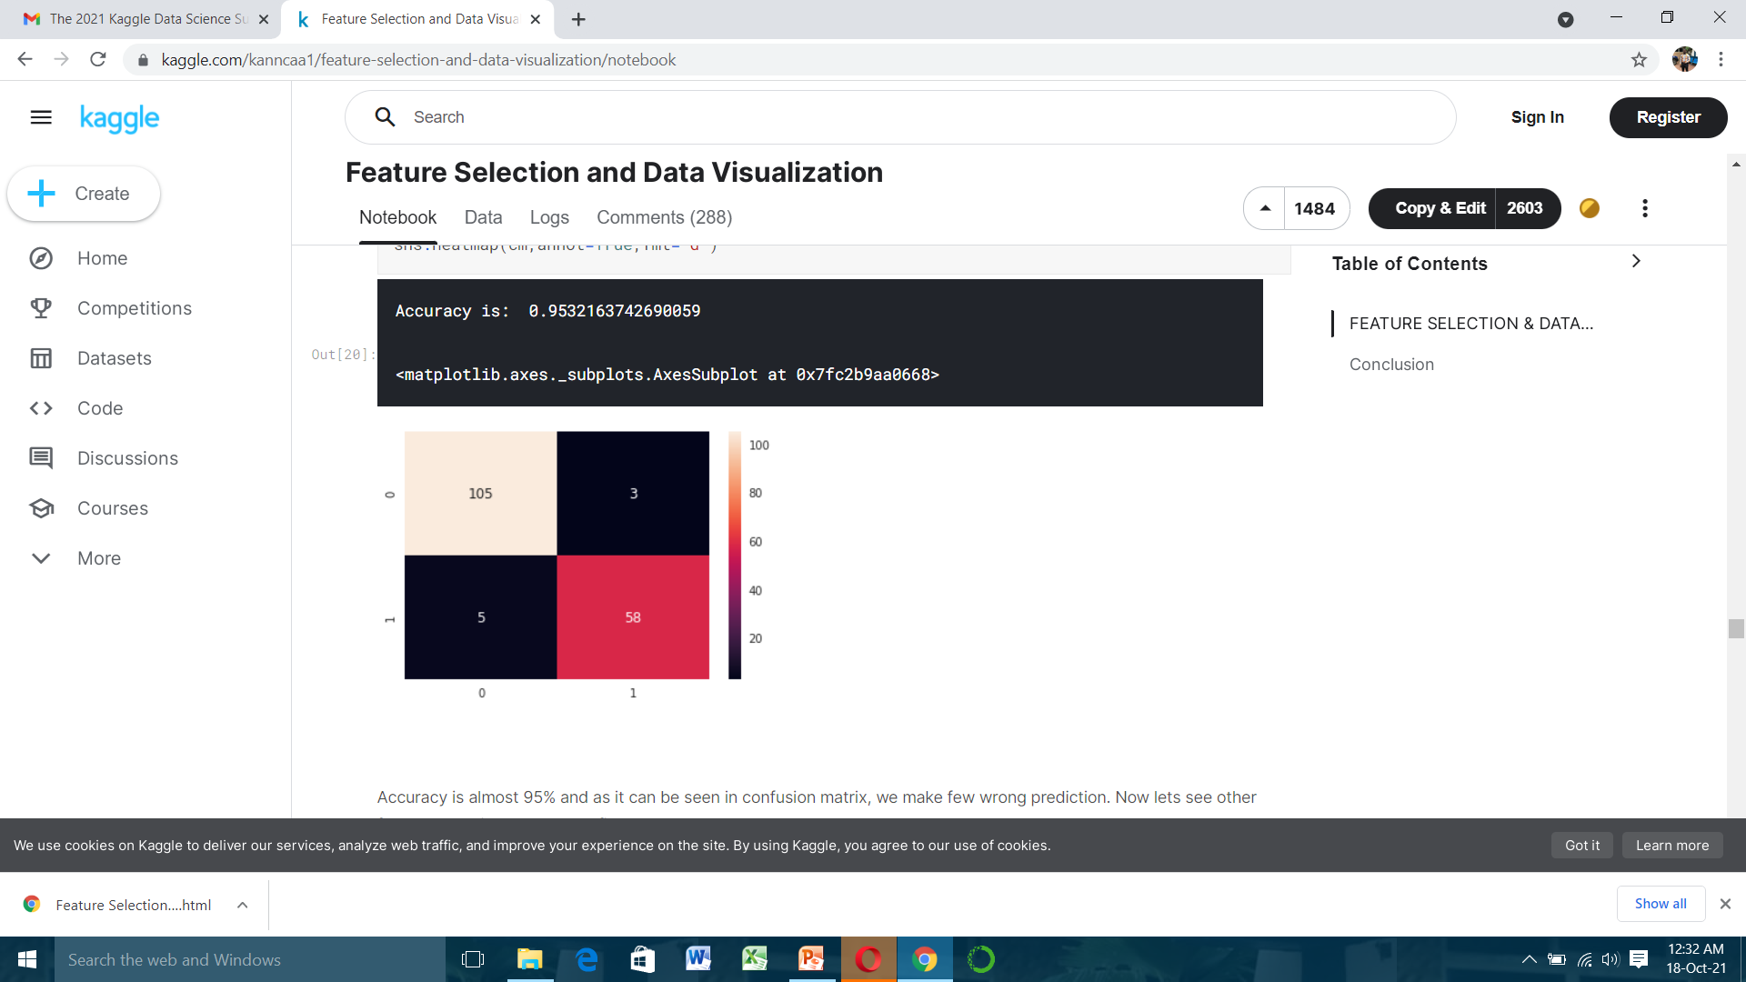
Well, we choose our features but did we choose correctly ? Lets use random forest and find accuracy according to chosen features.

Slide 28
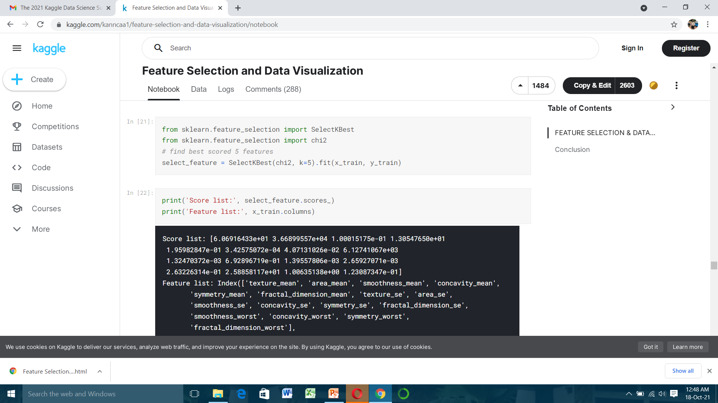
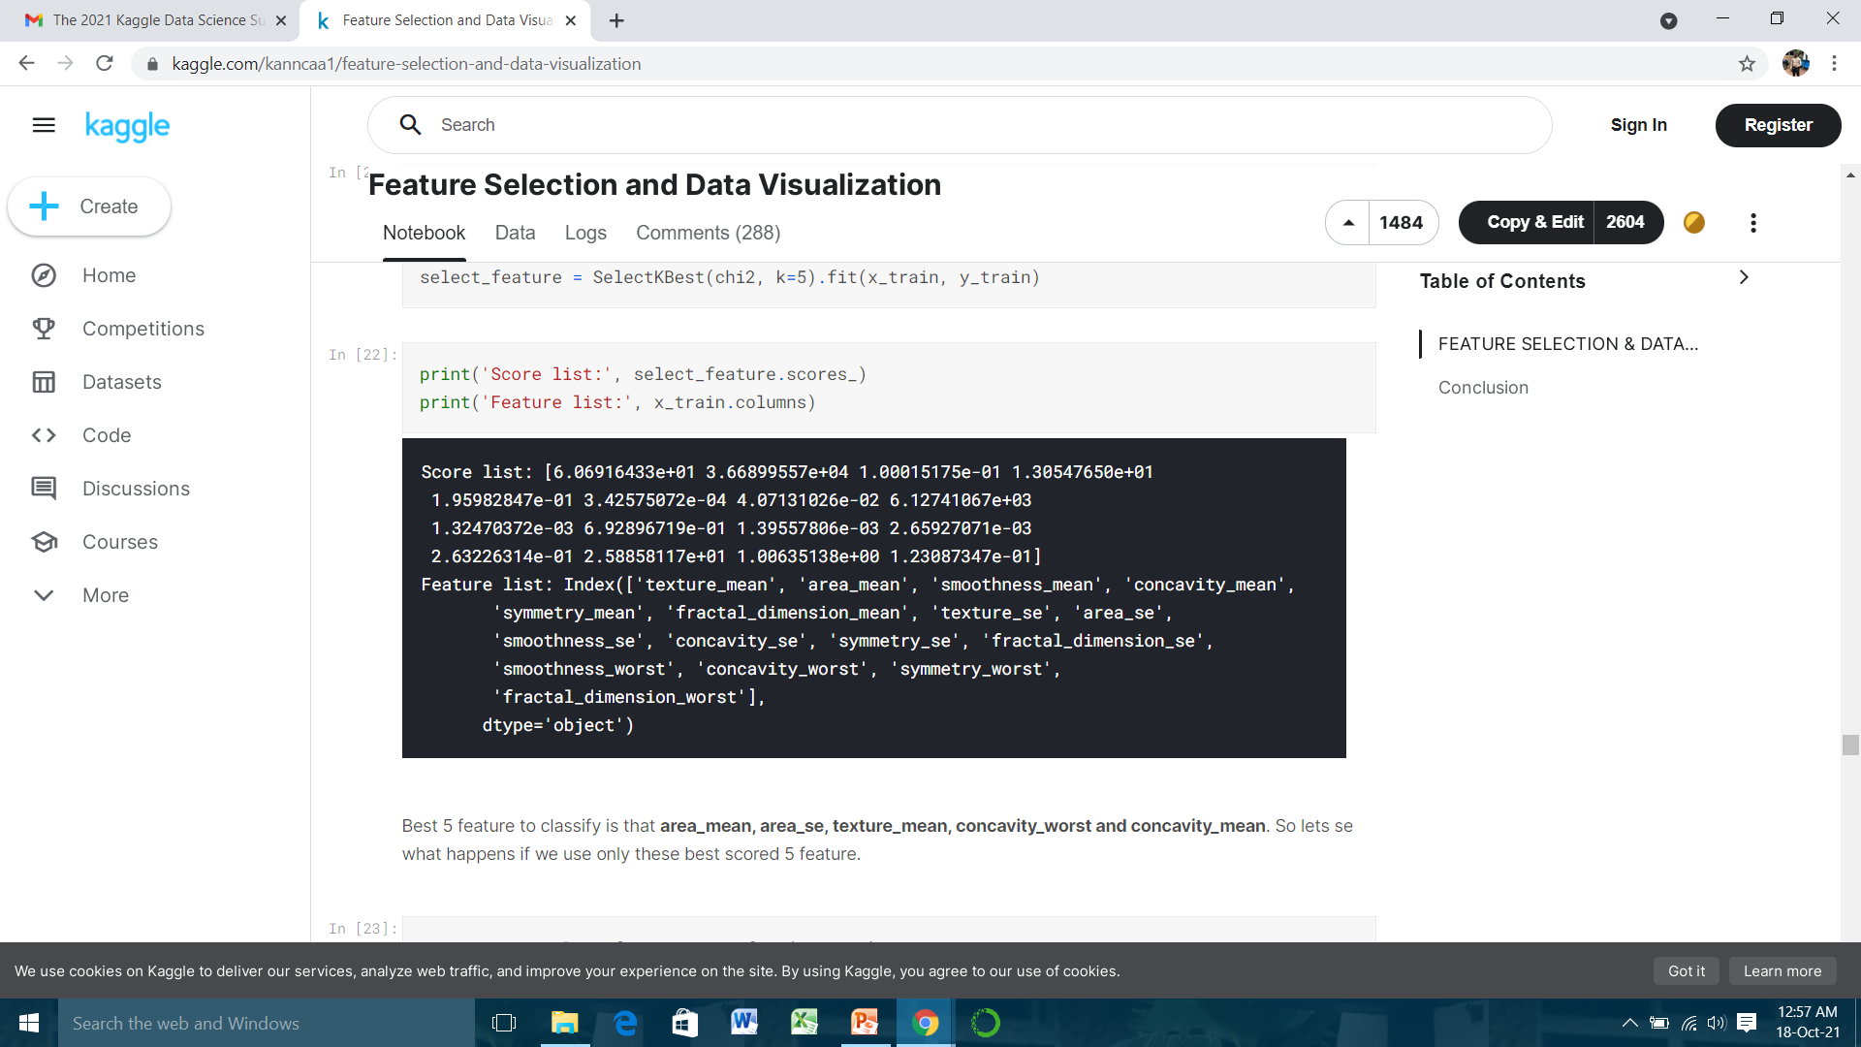
Accuracy is almost 95% and as it can be seen in confusion matrix, we make few wrong prediction. Now lets see other feature selection methods to find better results.
2) Univariate feature selection and random forest classification
In univariate feature selection, we will use Select K Best that removes all but the k highest scoring features.
In this method we need to choose how many features we will use. For example, will k (number of features) be 5 or 10 or 15? The answer is only trying or intuitively. I do not try all combinations but I only choose k = 5 and find best 5 features.

Slide 29
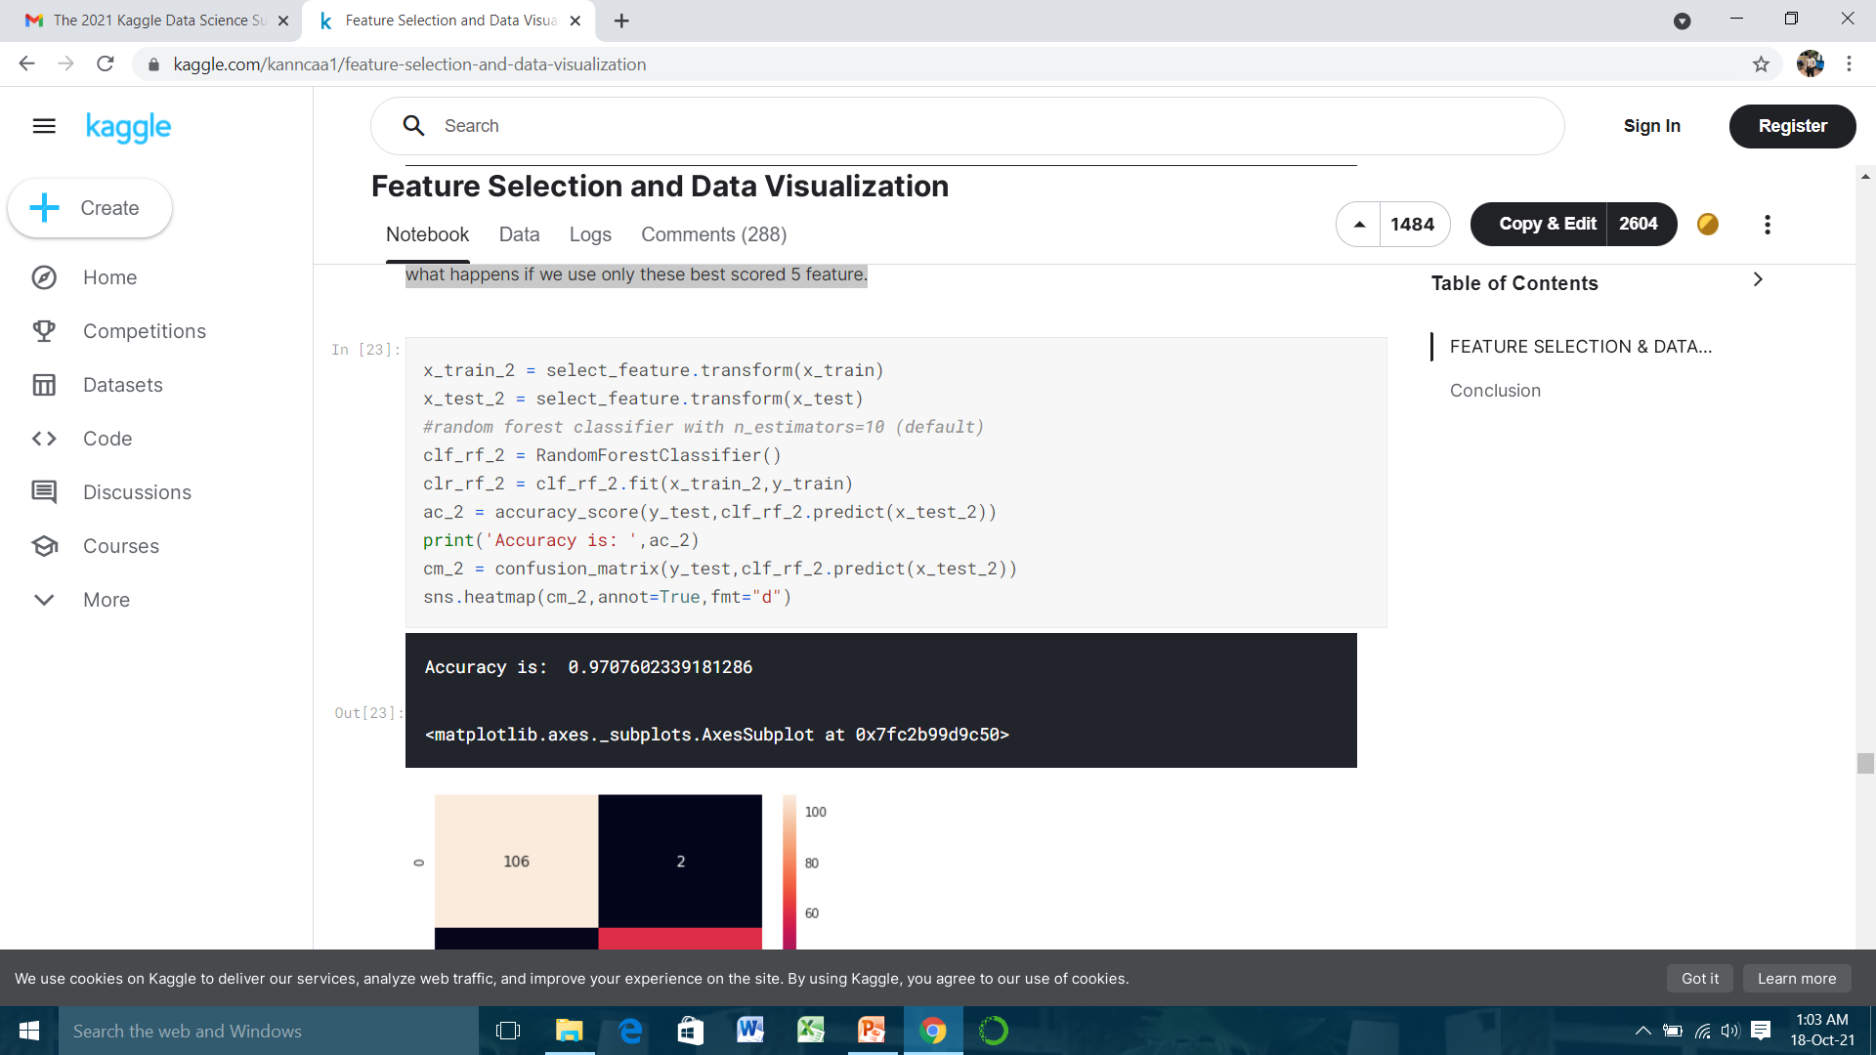
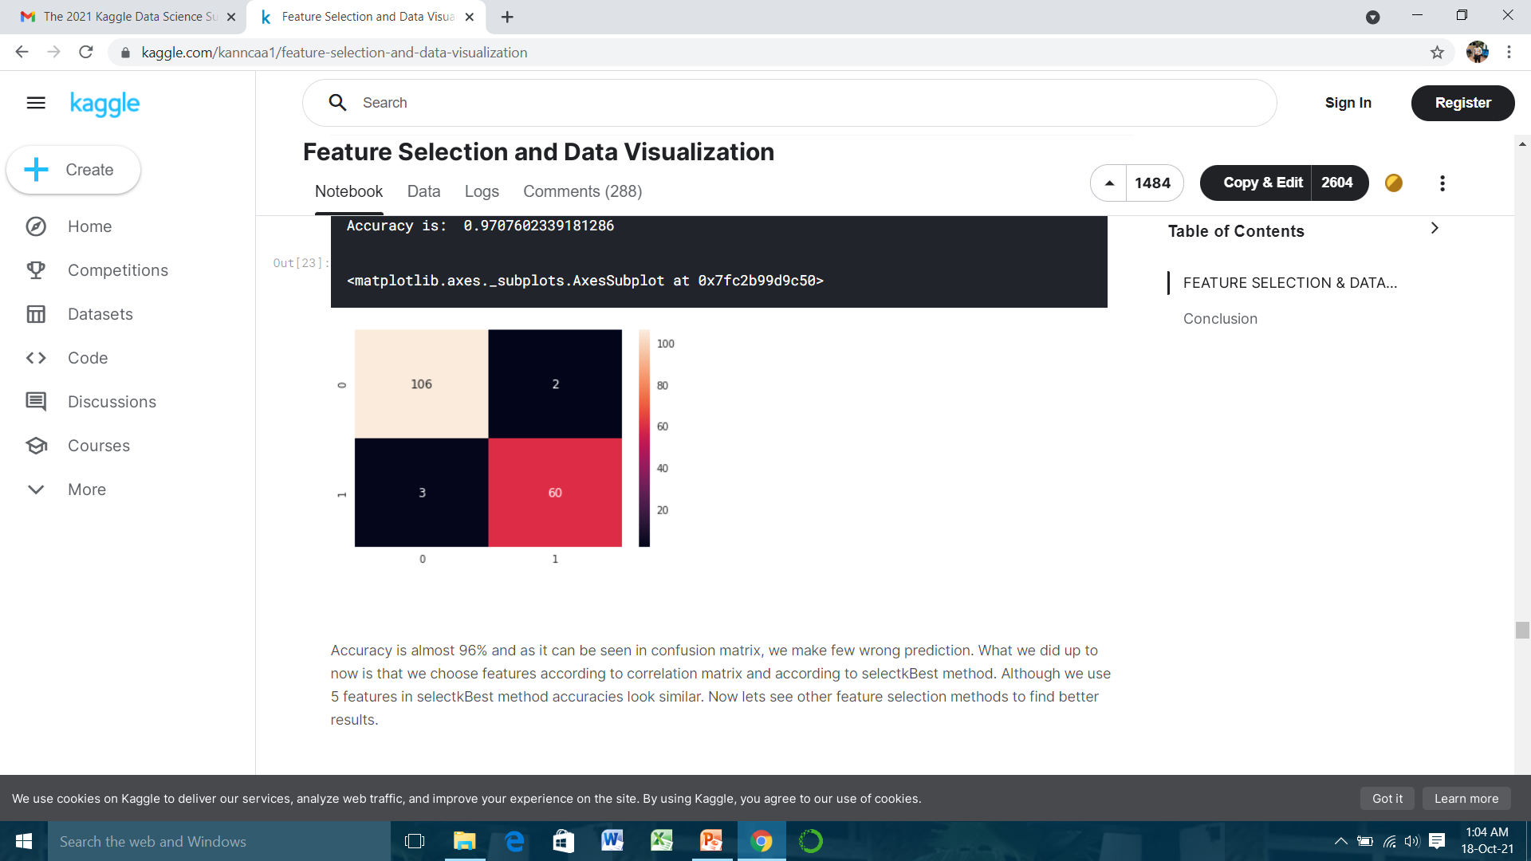
Best 5 feature to classify is that area mean, areas, texture mean, concavity worst and concavity mean. So lets se what happens if we use only these best scored 5 feature.

Slide 30
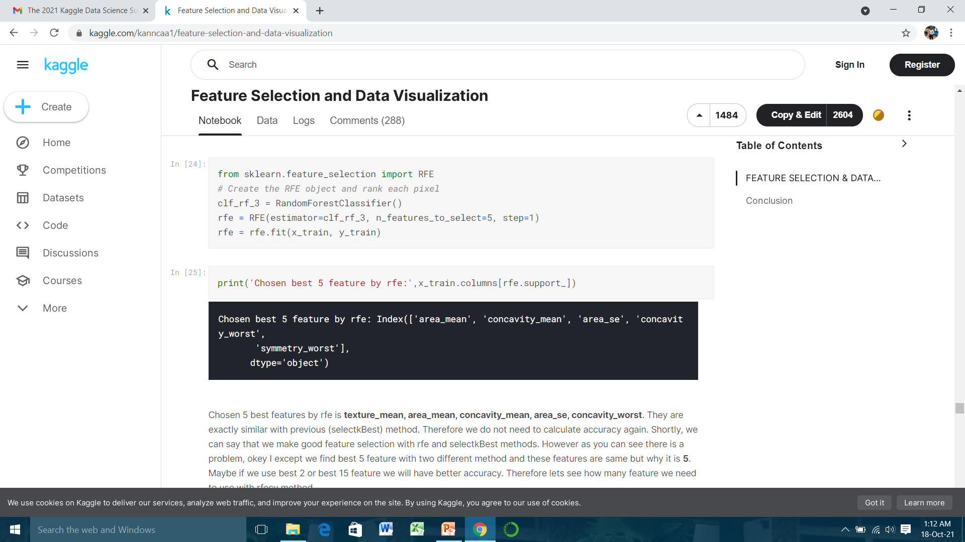
Accuracy is almost 96% and as it can be seen in confusion matrix, we make few wrong prediction. What we did up to now is that we choose features according to correlation matrix and according to selectkBest method. Although we use 5 features in selectkBest method accuracies look similar. Now lets see other feature selection methods to find better results.
3) Recursive feature elimination (RFE) with random forest
Basically, it uses one of the classification methods (random forest in our example), assign weights to each of features. Whose absolute weights are the smallest are pruned from the current set features. That procedure is recursively repeated on the pruned set until the desired number of features
Like previous method, we will use 5 features. However, which 5 features will we use ? We will choose them with RFE method.

Slide 31
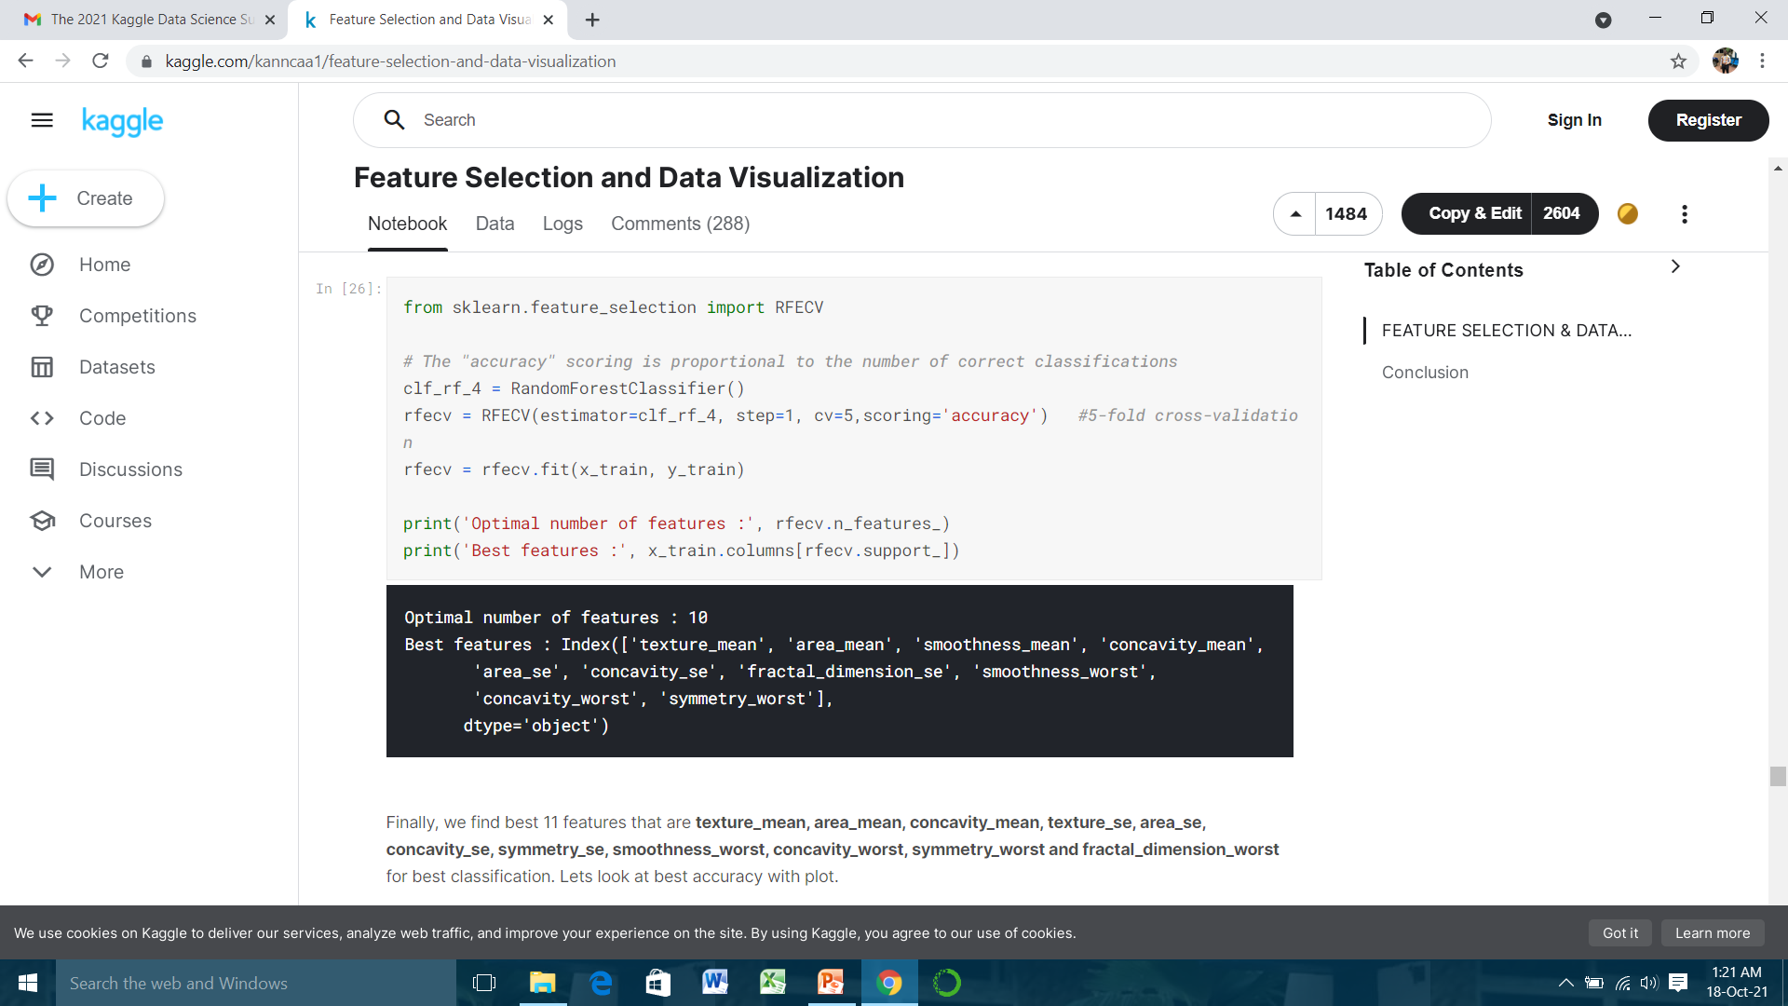
Chosen 5 best features by rfe is texture mean, area mean, concavity mean, areas, concavity worst. They are exactly similar with previous (selectkBest) method. Therefore we do not need to calculate accuracy again. Shortly, we can say that we make good feature selection with rfe and selectkBest methods. However as you can see there is a problem, okay I except we find best 5 feature with two different method and these features are same but why it is 5. Maybe if we use best 2 or best 15 feature we will have better accuracy. Therefore lets see how many feature we need to use with rfecv method.
4) Recursive feature elimination with cross validation and random forest classification
Now we will not only find best features but we also find how many features do we need for best accuracy.

Slide 32
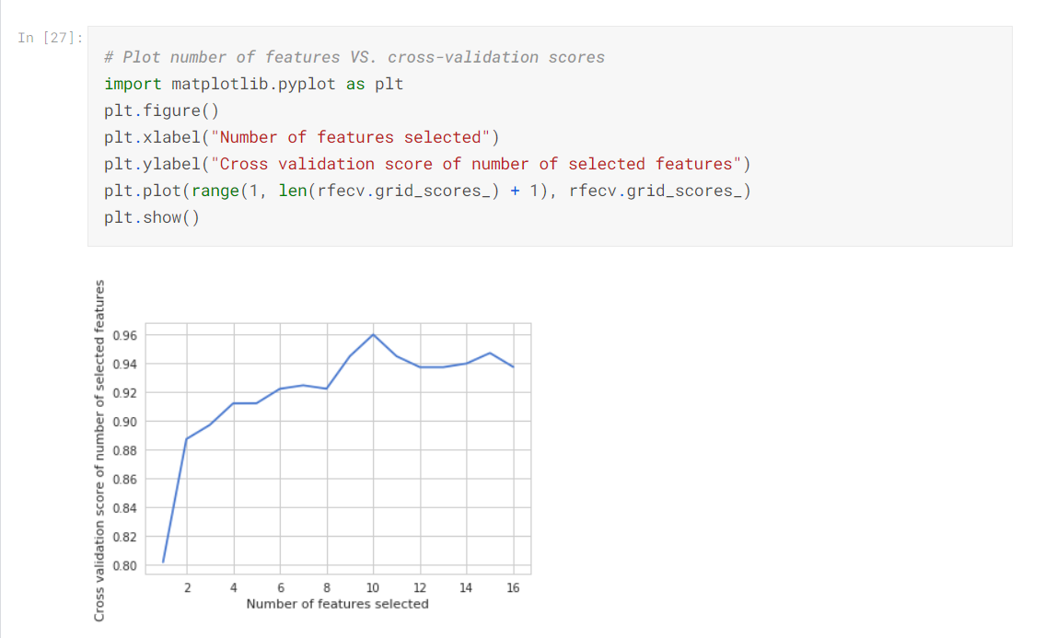
Finally, we find best 11 features that are texture mean, area mean, concavity mean, textures, areas, concavities, symmetries, smoothness worst, concavity worst, symmetry worst and fractal dimension worst for best classification. Lets look at best accuracy with plot.

Slide 33
Lets look at what we did up to this point. Lets accept that guys this data is very easy to classification. However, our first purpose is actually not finding good accuracy. Our purpose is learning how to make feature selection and understanding data.
Conclusion
Shortly, I tried to show importance of feature selection and data visualization. Default data includes 33 feature but after feature selection we drop this number from 33 to 5 with accuracy 95%. In this kernel we just tried basic things, I am sure with these data visualization and feature selection methods, you can easily exceed the % 95 accuracy. Maybe you can use other classification methods.

